Slide 1






Unpacking ERP Responses in Artificial Language Learning Pablo Bernabeu in collaboration with Christina Athanasiadi, Gabriella Silva, Stella Pischinger, My Ngoc Giang Hoang, Vincent deLuca, Jason Rothman, Claudia Poch, Iva Ivanova, Jorge González Alonso
LaBL
https://osf.io/974k8
13 February 2025

Slide 2
Morphosyntactic transfer
Initial heuristics
Cognitive economy
Facilitative or non-facilitative

Slide 3
Morphosyntactic transfer
Initial heuristics
Cognitive economy
Facilitative or non-facilitative
Third language (L3) context
transfer source(s) selected
information guiding the selection
time course of the selection

Slide 4
Morphosyntactic transfer
Initial heuristics
Cognitive economy
Facilitative or non-facilitative
Third language (L3) context
transfer source(s) selected
information guiding the selection
time course of the selection
LESS Project
Linguistic Economy through
transfer Source Selectivity

Slide 5
Transfer in L3 acquisition
Sources

Slide 6
Transfer in L3 acquisition
Sources
L2 by default
L1 and/or L2

Slide 7
Transfer in L3 acquisition
Sources
L2 by default
L2 Status Factor Model (Bardel & Falk, 2012)
L2 by default. Declarative memory for L2 and subsequent languages
L1 and/or L2

Slide 8
Transfer in L3 acquisition
Sources
L2 by default
L2 Status Factor Model (Bardel & Falk, 2012)
L2 by default. Declarative memory for L2 and subsequent languages
Cumulative Enhancement Model (Flynn et al., 2004)
Property-by-property and only facilitative
L1 and/or L2

Slide 9
Transfer in L3 acquisition
Sources
L2 by default
L2 Status Factor Model (Bardel & Falk, 2012)
L2 by default. Declarative memory for L2 and subsequent languages
Cumulative Enhancement Model (Flynn et al., 2004)
Property-by-property and only facilitative
Linguistic Proximity Model (Westergaard et al., 2017)
Property-by-property, with facilitative and non-facilitative outcomes
L1 and/or L2

Slide 10
Transfer in L3 acquisition
Sources
L2 by default
L2 Status Factor Model (Bardel & Falk, 2012)
L2 by default. Declarative memory for L2 and subsequent languages
Cumulative Enhancement Model (Flynn et al., 2004)
Property-by-property and only facilitative
Linguistic Proximity Model (Westergaard et al., 2017)
Property-by-property, with facilitative and non-facilitative cases
Typological Primacy Model (Rothman, 2011)
Full transfer from one language, based on overall structural similarity
L1 and/or L2

Slide 11
Morphosyntactic transfer in L3 acquisition

Slide 12
Morphosyntactic transfer in L3 acquisition
Confounds when using natural languages: age of acquisition, frequency of use, proficiency level, morphological salience, etc.

Slide 13
Morphosyntactic transfer in L3 acquisition
Confounds when using natural languages: age of acquisition, frequency of use, proficiency level, morphological salience, etc.
Workaround: artificial languages
Much more artificial than other lab studies?
Consider Buzz Lightyear versus Woody
versus humans.

Slide 14
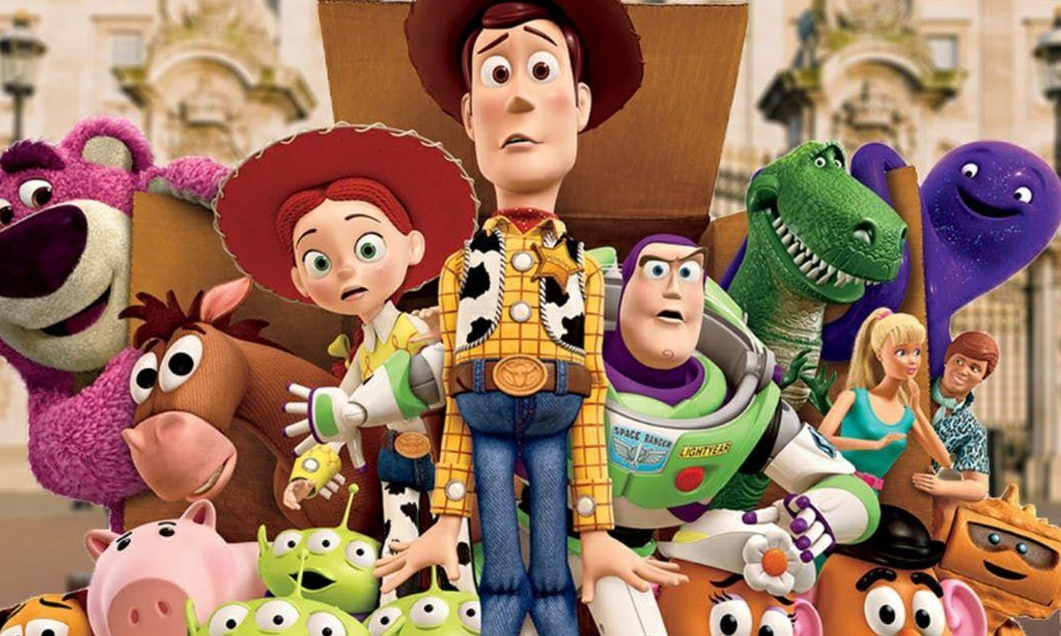
Morphosyntactic transfer in L3 acquisition
Confounds when using natural languages: age of acquisition, frequency of use, proficiency level, morphological salience, etc.
Workaround: artificial languages
Much more artificial than other lab studies?
Consider Buzz Lightyear versus Woody
versus humans.

Slide 15
Morphosyntactic transfer in L3 acquisition
Confounds when using natural languages: age of acquisition, frequency of use, proficiency level, morphological salience, etc.
Workaround: artificial languages
Much more artificial than other lab studies?
Consider Buzz Lightyear versus Woody
versus humans.
Compare experimental paradigms to
language in natural contexts.

Slide 16

Morphosyntactic transfer in L3 acquisition
Confounds when using natural languages: age of acquisition, frequency of use, proficiency level, morphological salience, etc.
Workaround: artificial languages
Much more artificial than other lab studies?
Consider Buzz Lightyear versus Woody
versus humans.
Compare experimental paradigms to
language in natural contexts.

Slide 17
Morphosyntactic transfer in L3 acquisition
Confounds when using natural languages: age of acquisition, frequency of use, proficiency level, morphological salience, etc.
Workaround: artificial languages
Consistency with natural language

Slide 18
Morphosyntactic transfer in L3 acquisition
Confounds when using natural languages: age of acquisition, frequency of use, proficiency level, morphological salience, etc.
Workaround: artificial languages
Consistency with natural language
Acquired by statistical learning (Hudson Kam & Newport, 2005; Kidd, 2012; Monaghan et al., 2023)
Similar processing signatures (Friederici et al., 2002; Uddén & Männel, 2018)

Slide 19
Morphosyntactic transfer in L3 acquisition
Confounds when using natural languages: age of acquisition, frequency of use, proficiency level, morphological salience, etc.
Workaround: artificial languages
Consistency with natural language
Acquired by statistical learning (Hudson Kam & Newport, 2005; Kidd, 2012; Monaghan et al., 2023)
Similar processing signatures (Friederici et al., 2002; Uddén & Männel, 2018)
An extensive training in the artificial language could be necessary for standard syntactic signatures (notably, P600) to appear in ERPs (González Alonso et al., 2020; Pereira Soares et al., 2022).

Slide 20
González Alonso et al. (2020)
Participants: L1 Spanish, L2 English
Artificial language groups: Mini-Spanish (n = 26), Mini-English (n = 24)
Grammatical property: gender agreement between nouns and predicative adjectives in copular sentences. Example:
Mini-Spanish: Jer mochil son carejur | Jer mochil son baratejur
Mini-English: Jer bag are expensivejur | Jer bag are cheapejur
Translation: The bags are expensive | The bags are cheap
Session phases: vocabulary pre-training → grammatical training → test (min. 80%) → ERP experiment → gender assignment task in Spanish

Slide 21
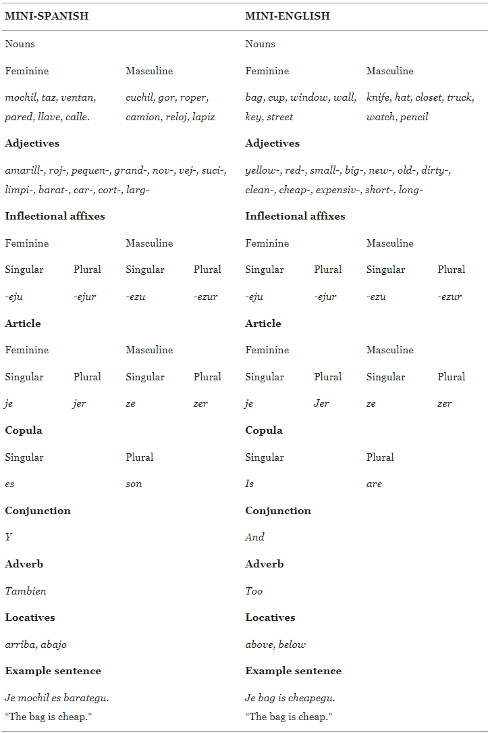
González Alonso et al. (2020)
Nouns
Nouns
Artificial languages
Je bag is cheapeju

Slide 22
González Alonso et al. (2020)
Pre-training

Slide 23
González Alonso et al. (2020)
Training

Slide 24
González Alonso et al. (2020)
Test

Slide 25
González Alonso et al. (2020)
Experiment

Slide 26
González Alonso et al. (2020)
Gender assignment
task in Spanish

Slide 27
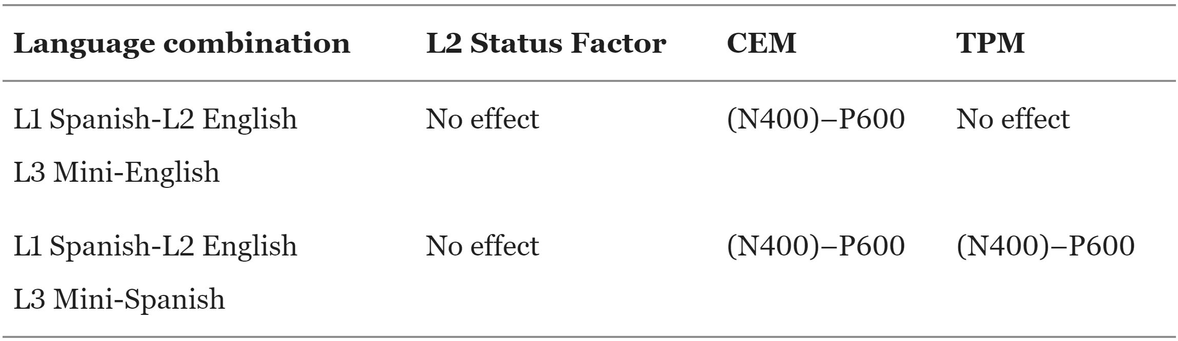
González Alonso et al. (2020)
Hypotheses (based on Rothman et al., 2015) under the assumption that transfer would happen before the ERP measurement.

Slide 28
González Alonso et al. (2020)
Results
Mini-Spanish group: broadly distributed 300–600 ms positivity, most consistent with attention-related P300.
No (N400)–P600
Interpretation: allocation of attentional resources in preparation for the selection of transfer source(s). In Mini-Spanish, larger focus on word-final gender morphology, consistent with Spanish.

Slide 29
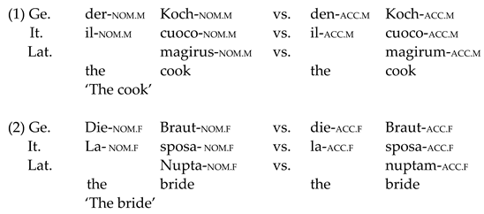
Pereira Soares et al. (2022)
Materials

Slide 30
Pereira Soares et al. (2022)
Hypotheses (based on Rothman et al., 2015) under the assumption that transfer would happen before the ERP measurement.
 | Case morphology |  | Adjective position
Language combination | TPM | LPM/SM | TPM | LPM/SM
L1 Italian—L1 German (L2 English)—L3 Mini-Latin | No effect | (N400)-P600 | (N400)-P600 | (N400)-P600
L1 German—L2 English—L3 Mini-Latin | No effect | (N400)-P600 | No effect | No effect

Slide 31
Pereira Soares et al. (2022)
Results
From the abstract: […] “N200/N400 deflection for the HSs in case morphology and a P600 effect for the German L2 group in adjectival position. None of the current L3/Ln models predict the observed results, which questions the appropriateness of this methodology.”

Slide 32
Our study
Sites: Tromsø and Madrid
Several groups per site
Six sessions
Three executive functions
Three grammatical properties
Several parts per session

Slide 33

Grammatical properties, examples, and presence in natural languages
Gender agreement | Zer watch are yellowezur and …
in Spanish and Norwegian
Differential object marking | Jessica provided fi ze key and …
in Spanish
Verb-object number agreement | John cleanedevo fi zer fikey and…
in none of these languages

Slide 34
Wrap-up buffer: … and ze watch too
Sentence wrap-up effects: Real? Dogma? Real?
Just and Carpenter (1980)
Stowe et al. (2018)
Desbordes et al. (2023)
Meister et al. (2022)

Slide 35

Wrap-up buffer: … and ze watch too
Sentence wrap-up effects: Real? Dogma? Real?
Just and Carpenter (1980)
Stowe et al. (2018)
Desbordes et al. (2023)
Meister et al. (2022)
The jury is still out.

Slide 36
Property | Artificial lang.
Gender agreement | Mini-Norwegian
 | Mini-English
Differential object marking | Mini-Norwegian
 | Mini-English
Verb-object number agreem. | Mini-Norwegian
 | Mini-English
Property | Group | Artificial lang.
Gender agreement | L1 Eng, L2 Spa | Mini-Spanish
 | L1 Eng L2 Sp | Mini-English
 | L1 Spa, L2 Eng | Mini-Spanish
 | L1 Sp L2 Eng | Mini-English
Differential object marking | L1 Eng, L2 Spa | Mini-Spanish
 | L1 Eng L2 Sp | Mini-English
 | L1 Spa, L2 Eng | Mini-Spanish
 | L1 Sp L2 Eng | Mini-English
Verb-object number agreement | L1 Eng, L2 Spa | Mini-Spanish
 | L1 Eng L2 Sp | Mini-English
 | L1 Spa, L2 Eng | Mini-Spanish
 | L1 Sp L2 Eng | Mini-English

Slide 37
Sessions
Session 1. Individual differences (home-based session)
Working memory (digit span), selective attention (Stroop) and implicit learning (serial reaction time)
Language History Questionnaire (LHQ3; Li et al., 2020)

Slide 38
Sessions
Session 1. Individual differences (home-based session)
Working memory (digit span), selective attention (Stroop) and implicit learning (serial reaction time)
Language History Questionnaire (LHQ3; Li et al., 2020)
+ 1 week: Session 2. Gender agreement
Session begins with resting-state EEG (eyes-open, eyes-closed counterbalanced across participants)

Slide 39
Sessions
Session 1. Individual differences (home-based session)
Working memory (digit span), selective attention (Stroop) and implicit learning (serial reaction time)
Language History Questionnaire (LHQ3; Li et al., 2020)
+ 1 week: Session 2. Gender agreement
Session begins with resting-state EEG (eyes-open, eyes-closed counterbalanced across participants)
+ 1 week: Session 3. Differential object marking + Gender agreement
Training only in the new property
Experiment part contains both properties intermixed

Slide 40
Sessions
Session 1. Individual differences (home-based session)
Working memory (digit span), selective attention (Stroop) and implicit learning (serial reaction time)
Language History Questionnaire (LHQ3; Li et al., 2020)
+ 1 week: Session 2. Gender agreement
Session begins with resting-state EEG (eyes-open, eyes-closed counterbalanced across participants)
+ 1 week: Session 3. Differential object marking + Gender agreement
Training only in the new property
Experiment part contains both properties intermixed
+ 1 week: Session 4. Verb-object agreement + Differential object marking + Gender agreement
Same mechanism as in the previous session

Slide 41
Sessions
Session 1. Individual differences (home-based session)
Working memory (digit span), selective attention (Stroop) and implicit learning (serial reaction time)
Language History Questionnaire (LHQ3; Li et al., 2020)
+ 1 week: Session 2. Gender agreement
Session begins with resting-state EEG (eyes-open, eyes-closed counterbalanced across participants)
+ 1 week: Session 3. Differential object marking + Gender agreement
Training only in the new property
Experiment part contains both properties intermixed
+ 1 week: Session 4. Verb-object agreement + Differential object marking + Gender agreement
Same mechanism as in the previous session
+ 1 week: Session 5. Retest of executive functions (home-based session)

Slide 42
Sessions
Session 1. Individual differences (home-based session)
Working memory (digit span), selective attention (Stroop) and implicit learning (serial reaction time)
Language History Questionnaire (LHQ3; Li et al., 2020)
+ 1 week: Session 2. Gender agreement
Session begins with resting-state EEG (eyes-open, eyes-closed counterbalanced across participants)
+ 1 week: Session 3. Differential object marking + Gender agreement
Training only in the new property
Experiment part contains both properties intermixed
+ 1 week: Session 4. Verb-object agreement + Differential object marking + Gender agreement
Same mechanism as in the previous session
+ 1 week: Session 5. Retest of executive functions (home-based session)
+ 4 months: Session 6. Retest of all grammatical properties (Morgan-Short et al., 2012)
Session ends with control tests on the relevant properties in the natural languages

Slide 43
Creation of the artificial languages
Cognates avoided: lexicons tailored to Norwegian and Spanish sites.
Content words (n, adj, adv, v): translated across the two artificial languages in each site, and ideally across the three mini-languages.
Must be picturable (González Alonso et al., 2020; Wendebourg et al., 2025)
Adjectives paired by meaning, mostly by antonymy.
Morphemes: same across the two artificial languages in each site, and ideally across the three mini-languages.
Design and materials described in González Alonso et al. (2025).

Slide 44
Stimulus creation: Phonological and semantic challenges
SPA_noun | ENG_noun | NOR_noun
habitación | bedroom | soverom
mochil | bag | bag
nuez | walnut | valnøtt
perch | hanger | henger
raiz | root | rot
taz | cup | kopp
ventan | window | vindu
aguacate | avocado | avokado
cuchil | knife | kniv
gor | hat | hatt
reloj | watch | klokke
zapat | shoe | sko
malet | suitcase | koffert
mes | table | bord
etiquet | label | merkelapp
blue | blaa
white | hvit
first | foerst
last | sist
good | bra
bad | daarlig
easy | lett

Slide 45
Creation of the artificial languages
Modular framework formed of interoperable components
Minimal components of each language contained in a base file
Linguistic and visual stimuli finally presented are created by assembling minimal components.
Several controls exerted on the stimuli to prevent spurious effects. For instance, gender and number are counterbalanced across experimental conditions. Similarly, words and experimental conditions within the same set appear equally often.

Slide 46
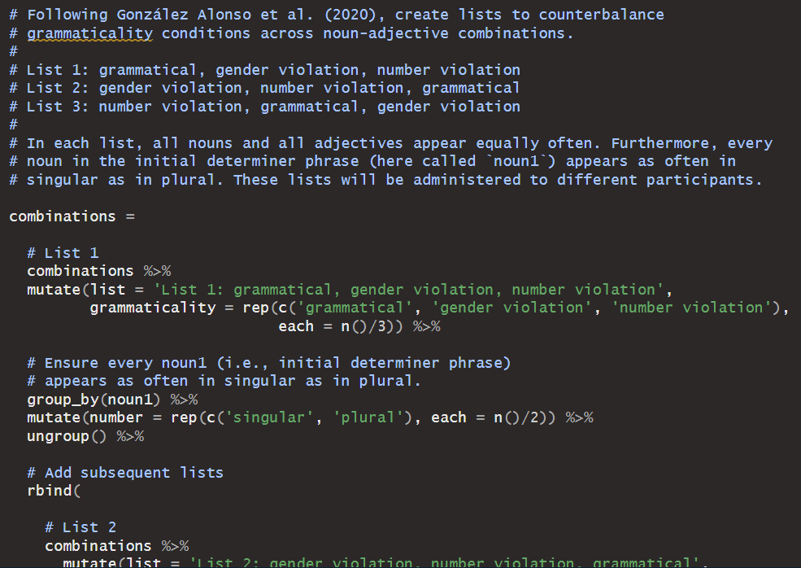

Slide 47
Creation of the artificial languages
Modular framework formed of interoperable components
Minimal components of each language contained in a base file
Linguistic and visual stimuli finally presented are created by assembling minimal components.
Several controls exerted on the stimuli to prevent spurious effects. For instance, gender and number are counterbalanced across experimental conditions. Similarly, words and experimental conditions within the same set appear equally often.
All stimuli compiled through R scripts

Slide 48
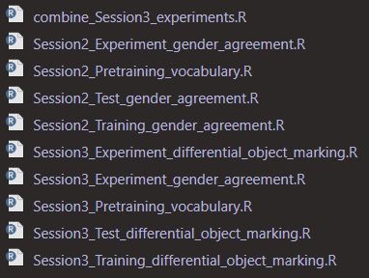
All scripts are run from a core script.

Slide 49
Creation of the artificial languages
Modular framework formed of interoperable components
Minimal components of each language contained in a base file
Linguistic and visual stimuli finally presented are created by assembling minimal components.
Several controls exerted on the stimuli to prevent spurious effects. For instance, gender and number are counterbalanced across experimental conditions. Similarly, words and experimental conditions within the same set appear equally often.
All stimuli compiled through R scripts
Present framework facilitates reproducibility and inspection of stimuli, and allows extensions
Parallel lists of stimuli used to enable some of the controls
Open-source software OpenSesame used to present the stimuli and collect responses

Slide 50

Creation of the artificial languages
Modular framework formed of interoperable components
Minimal components of each language contained in a base file
Linguistic and visual stimuli finally presented are created by assembling minimal components.
Several controls exerted on the stimuli to prevent spurious effects. For instance, gender and number are counterbalanced across experimental conditions. Similarly, words and experimental conditions within the same set appear equally often.
All stimuli compiled through R scripts
Present framework facilitates reproducibility and inspection of stimuli, and allows extensions
Parallel lists of stimuli used to enable some of the controls
Open-source software OpenSesame used to present the stimuli and collect responses
Reproducible, testable, reusable materials available at https://osf.io/wbjyr

Slide 51

Stimuli ahead
Example of stimuli presented next include different mini-languages.
Mini-languages were distributed between groups. Each participant saw one mini-language only.
Semantic information, particularly using pictures, helps in artificial language learning. It boosts performance, reduces perceived effort and increases enjoyment (Wendebourg et al., 2025).

Slide 52
Gender agreement
Introduced, trained on and tested on in Session 2
Maintained across subsequent sessions

Slide 53
Training in gender agreement

Slide 54
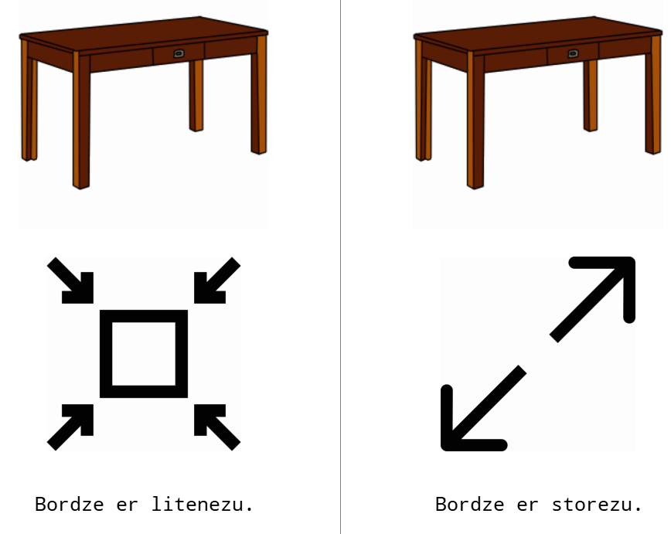
Training in gender agreement

Slide 55
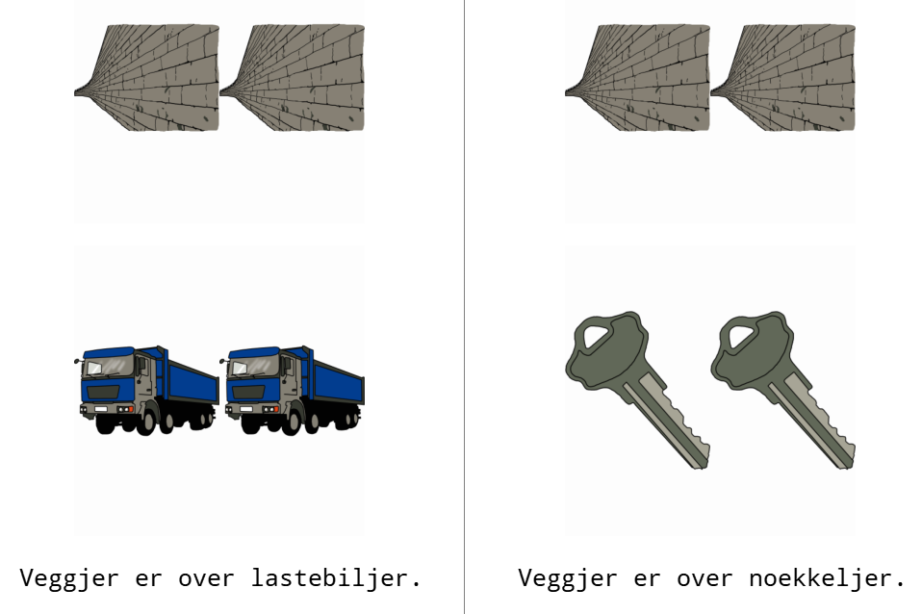
Locative filler during training

Slide 56
Test on gender agreement - Session 2 Match image to one of five sentences
1. Correct
2. Gender agreement violation
3. Number agreement violation
4. Gender and number agreement violation
5. Semantic violation (i.e., opposite adjective)

Slide 57
Test on gender agreement - Session 2 Match image to one of five sentences
1. Correct
2. Gender agreement violation
3. Number agreement violation
4. Gender and number agreement violation
5. Semantic violation (i.e., opposite adjective)
If accuracy < 80%, training and test are repeated.

Slide 58


Slide 59
Differential object marking
Introduced, trained on and tested on in Session 3
Maintained across subsequent sessions

Slide 60
Training in differential object marking

Slide 61
Locative filler during training

Slide 62
Test on differential object marking - Session 3 Match image to one of five sentences
1. Correct
2. DOM violation (i.e., object noun without DOM)
3. Article with number violation
4. Misplaced article
5. Noun with semantic violation (i.e., noun different from image)

Slide 63
Test on differential object marking - Session 3 Match image to one of five sentences
1. Correct
2. DOM violation (i.e., object noun without DOM)
3. Article with number violation
4. Misplaced article
5. Noun with semantic violation (i.e., noun different from image)
If accuracy < 80%, training and test are repeated.

Slide 65
Verb-object number agreement

Slide 66
Training in verb-object number agreement

Slide 67
Test on verb-object number agreement

Slide 68
Test on verb-object number agreement
If accuracy < 80%, training and test are repeated.

Slide 69
Examples of conditions of interest
zer watch are yellowejur and zer pencil too Gender agreement violation
Jessica chose fi je street and fi ze roof too. Correct differential object marking
Thomas chose je key but not je backpack. Violation of differential object
marking (missing fi)
∅
∅

Slide 70
Examples of control conditions
zer watch are yellowezu and zer pencil too Number violation (missing r)
Jessica provided fi zekey and fi zewall too Article misplacement
Ole bestilte fi jevegg og fi zetak ogsaa. Article misplacement
∅

Slide 71
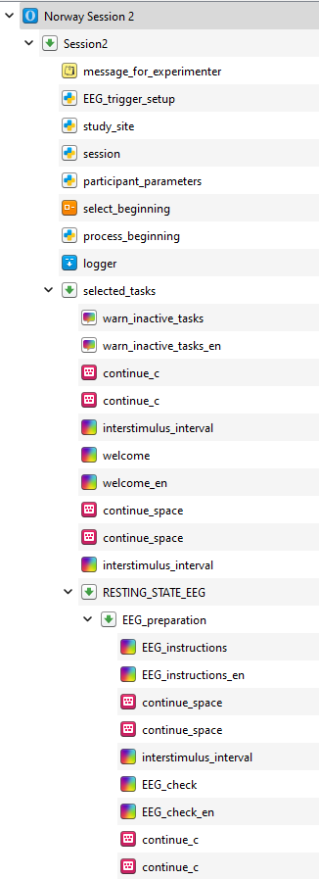
Lab sessions
Instructions written in the language corresponding to each artificial language group (e.g., in Norwegian for the Mini-Norwegian group).
Sufficient written instructions to avoid linguistic influence through spoken explanations.

Slide 72
Preliminary results
~ 23 participants per mini-language group by Session 5
~ 11 participants per mini-language group by Session 6
- Data collection will continue over the next few months.

Slide 73
Accuracy of grammaticality judgements

Slide 74
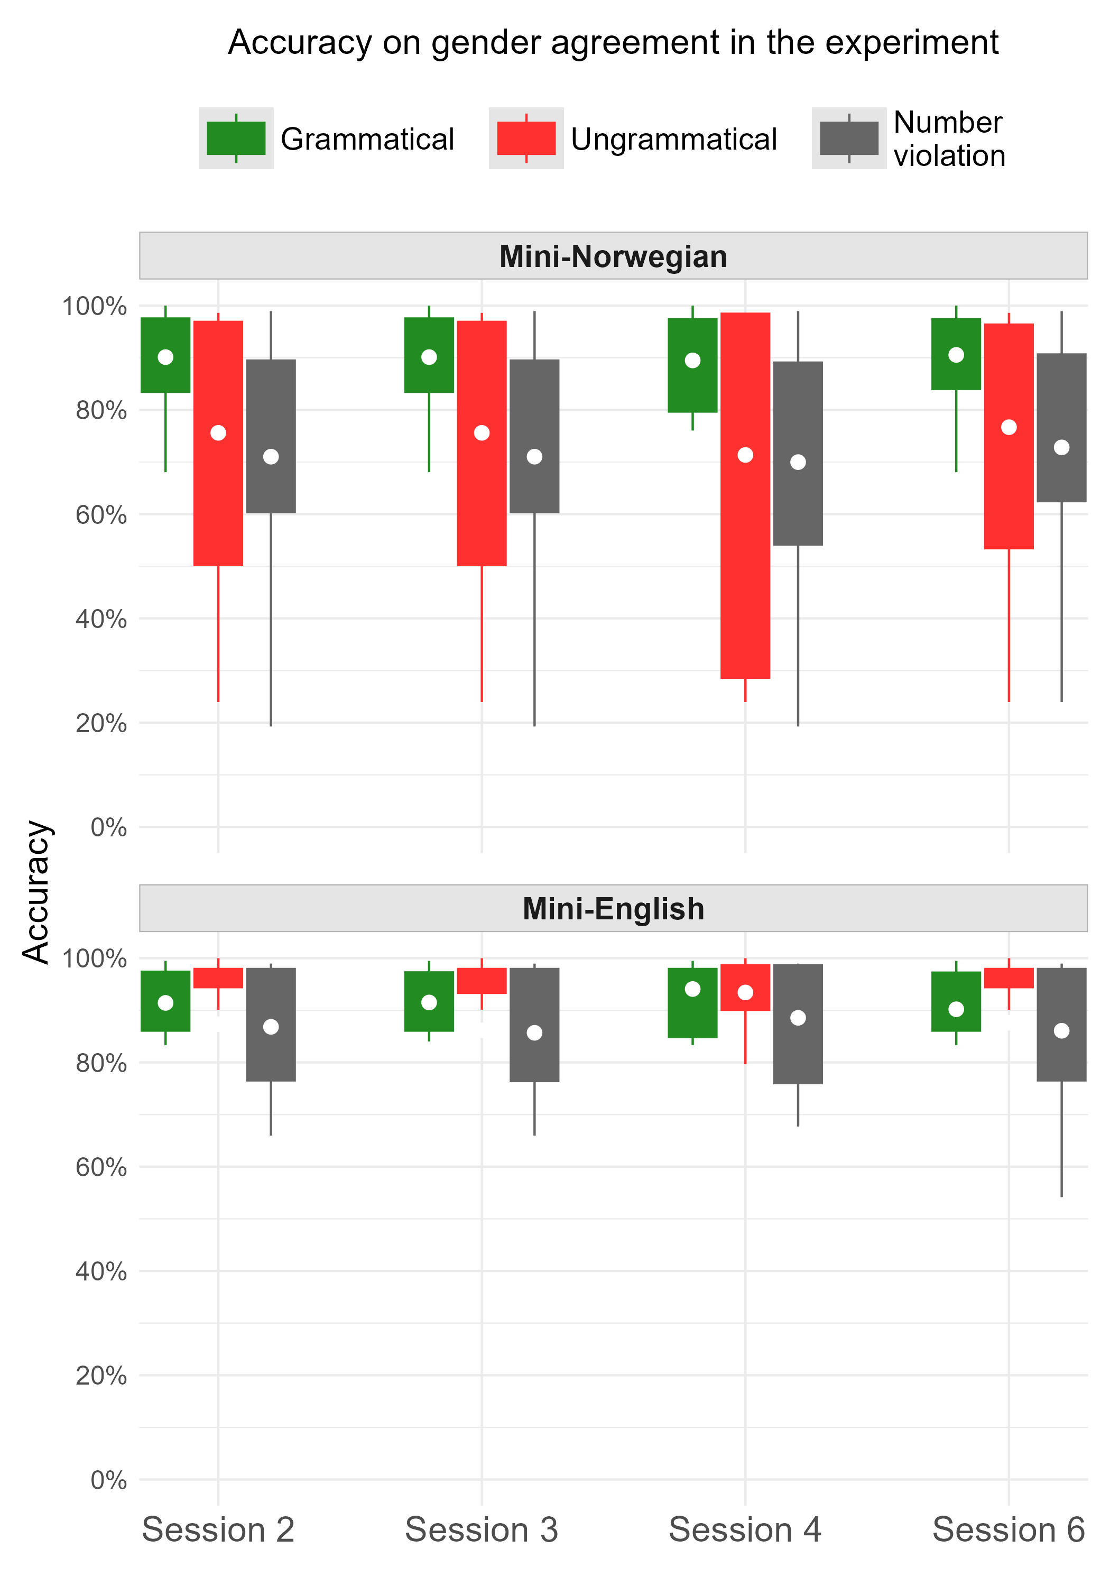

Slide 75
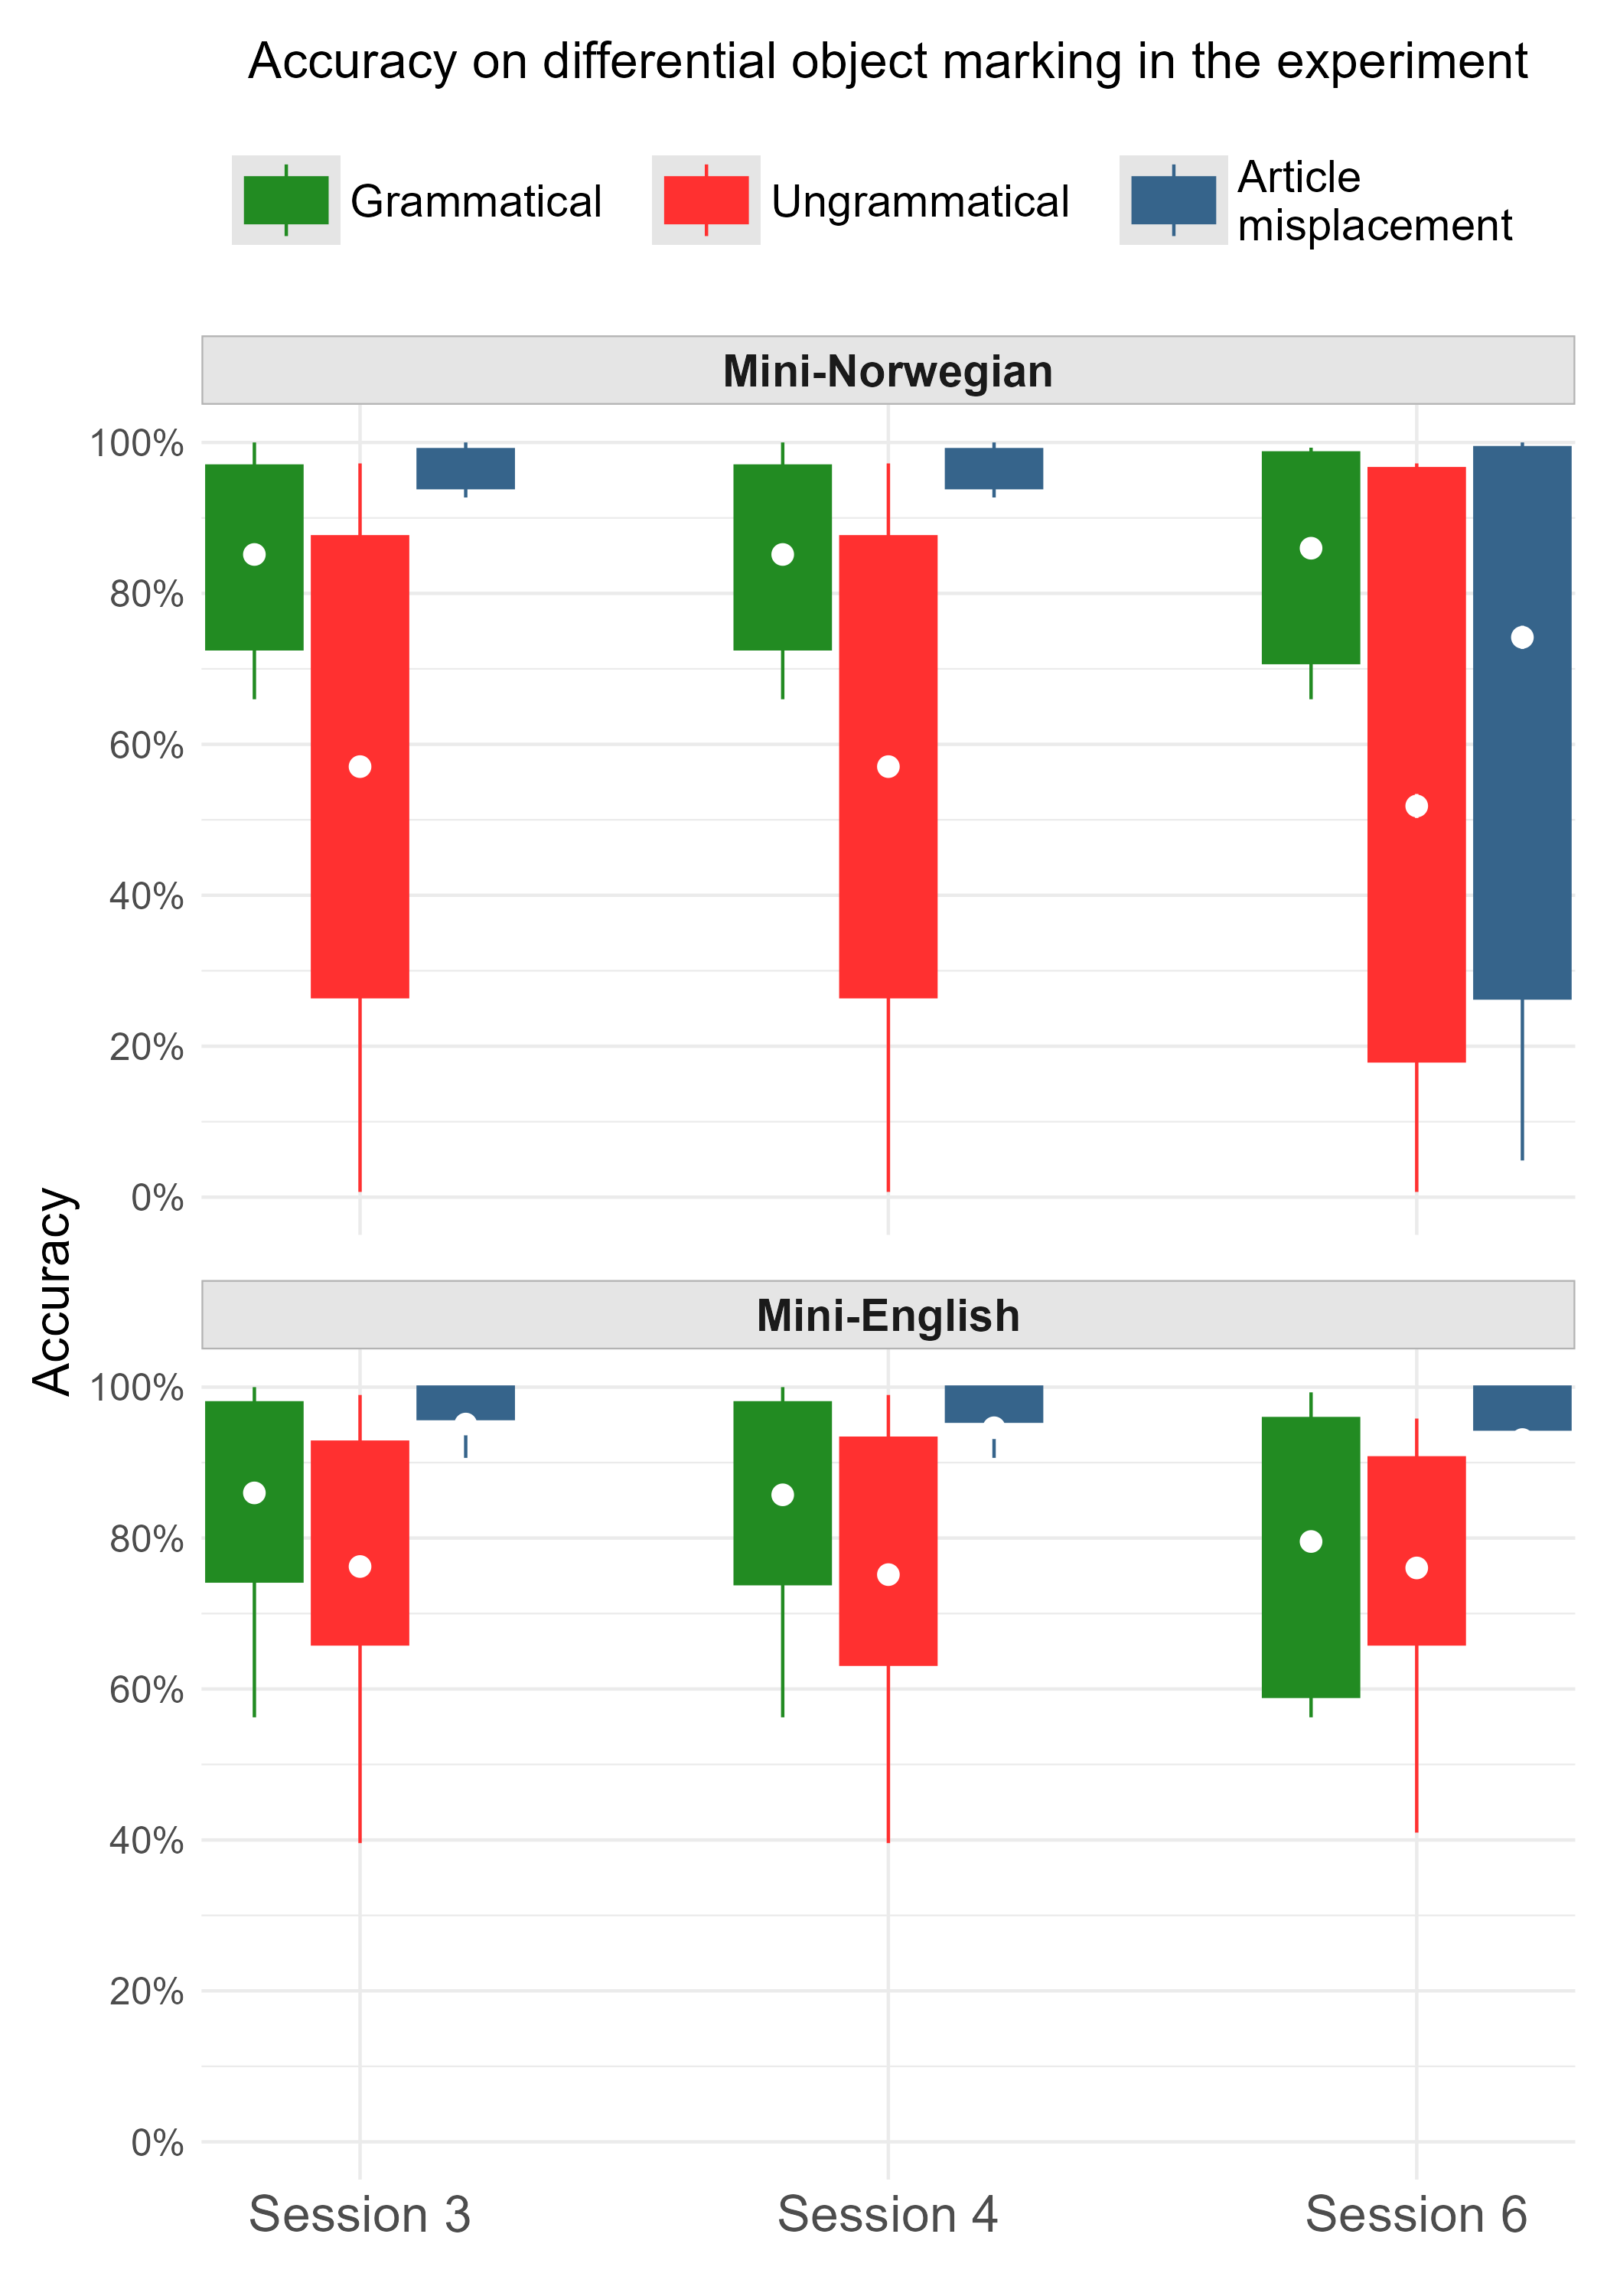

Slide 76
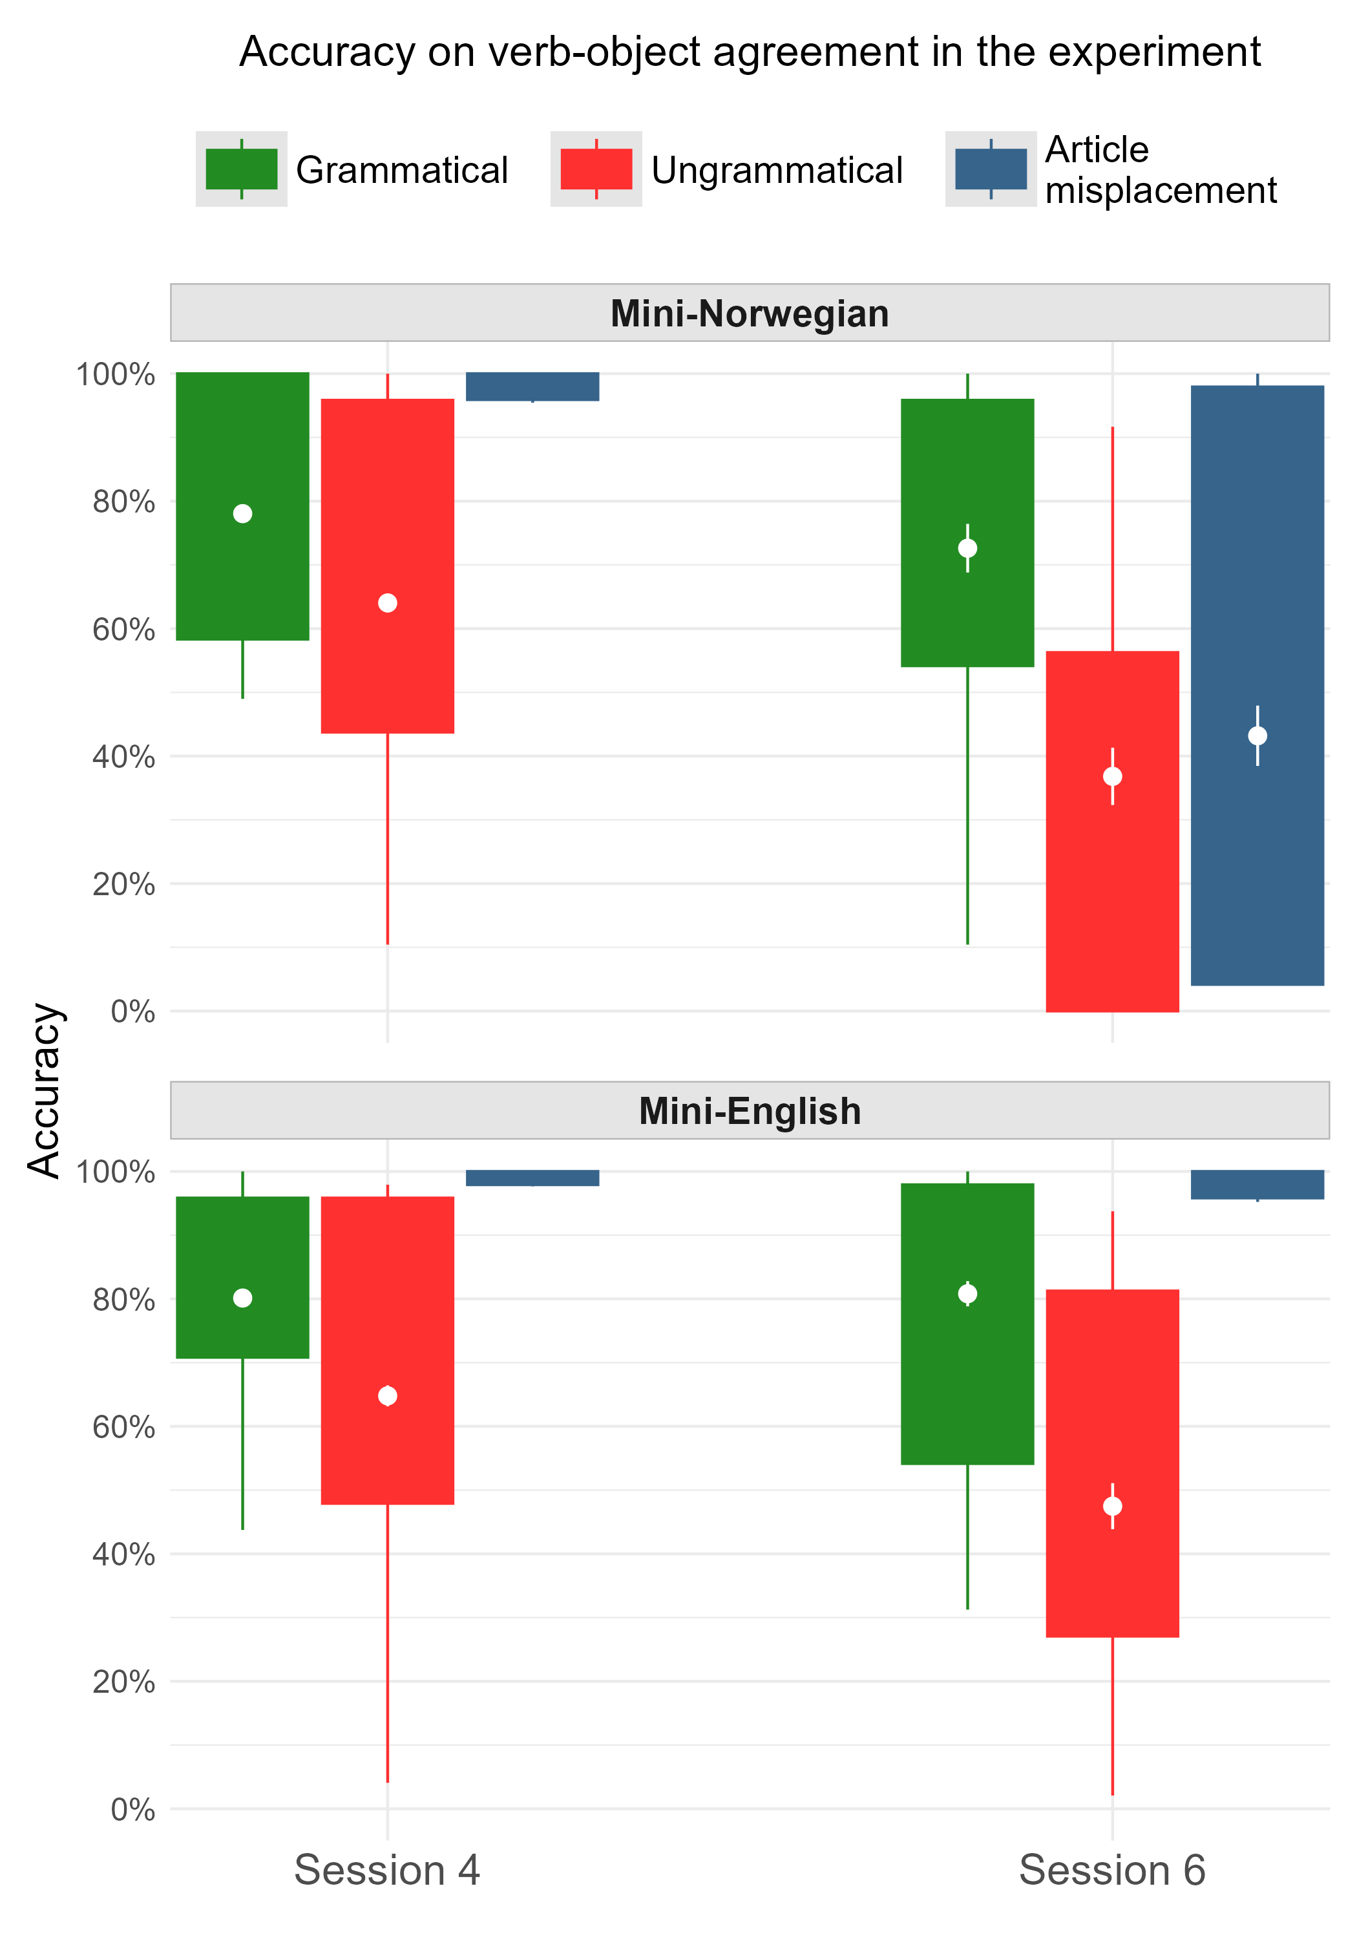

Slide 77
Event-related potentials
To be presented next…
Midline medial region: generally representative of other regions in the current data.
Per grammatical property
Per session

Slide 78
Gender agreement

Slide 79
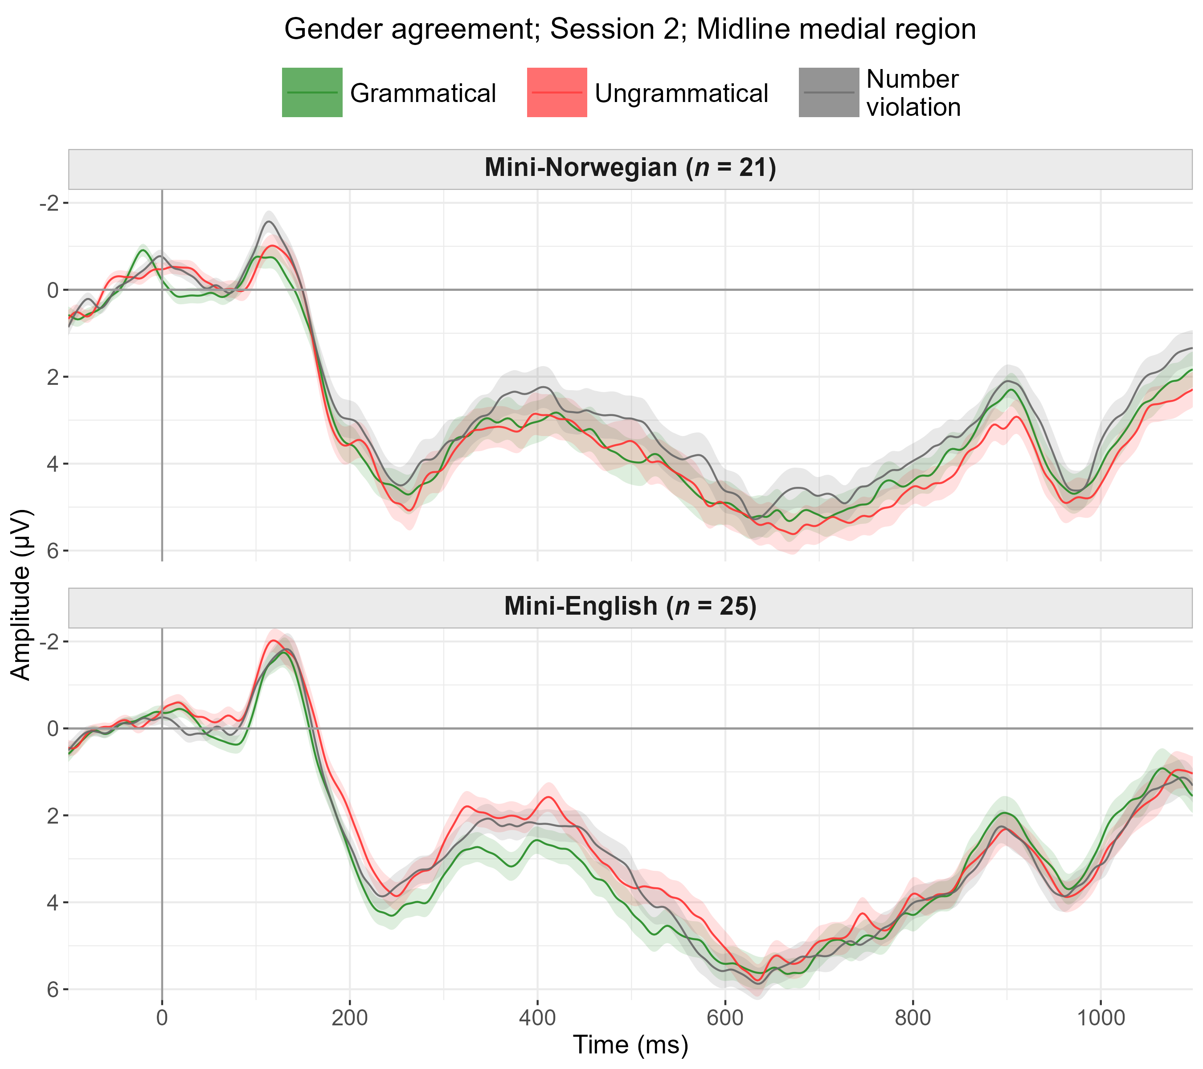

Slide 80
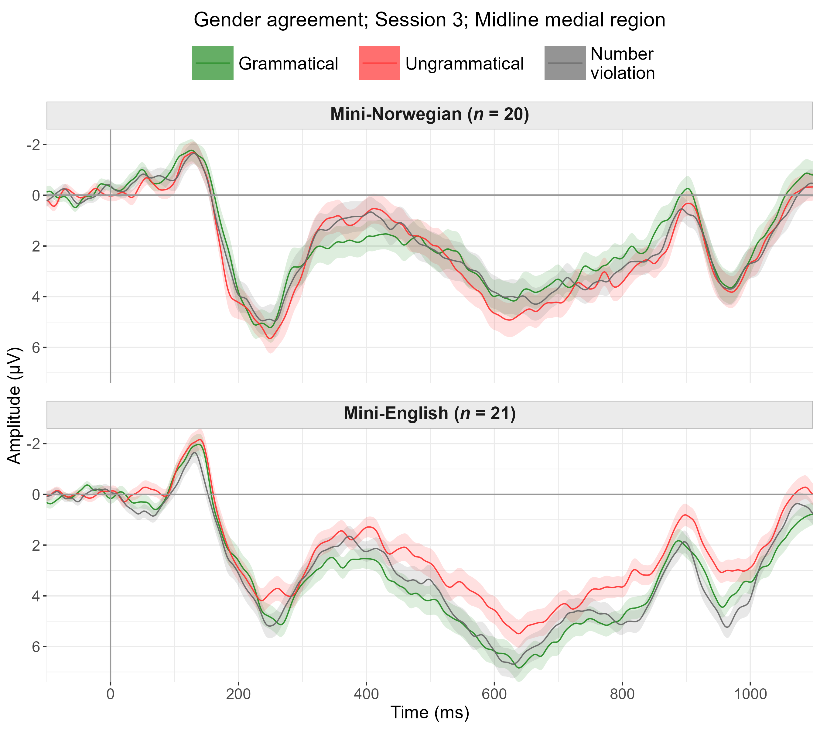

Slide 81
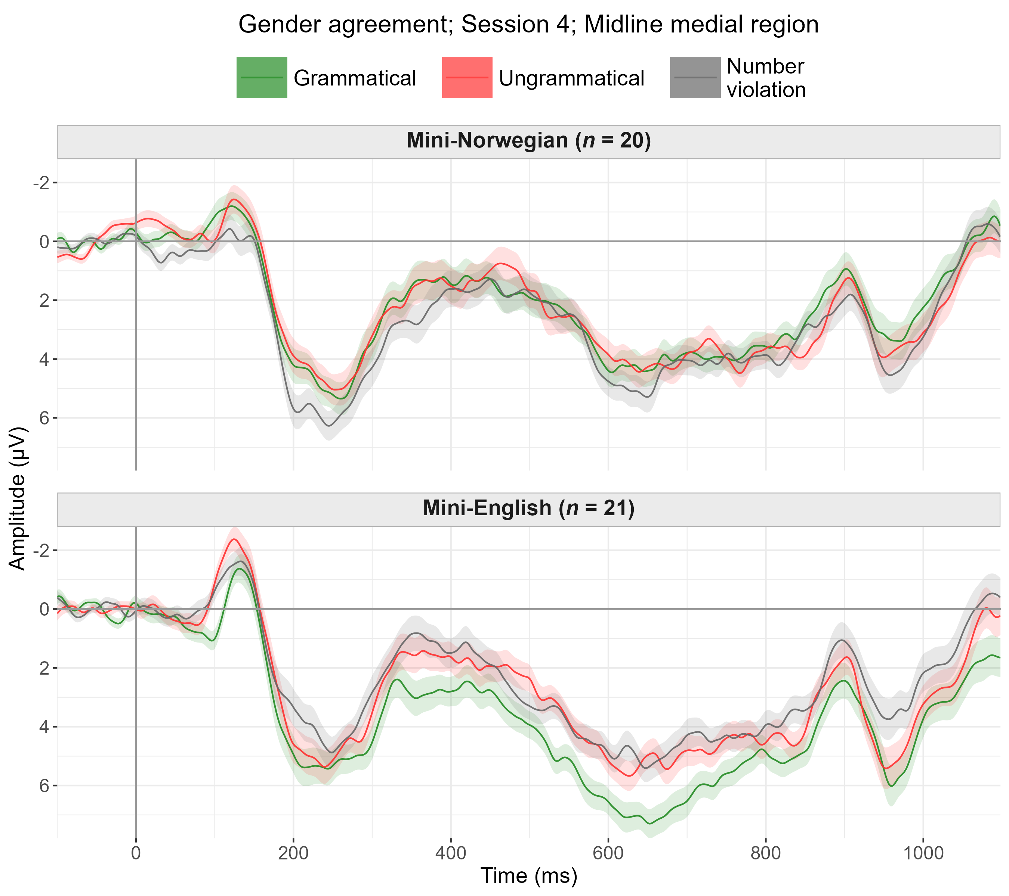

Slide 82
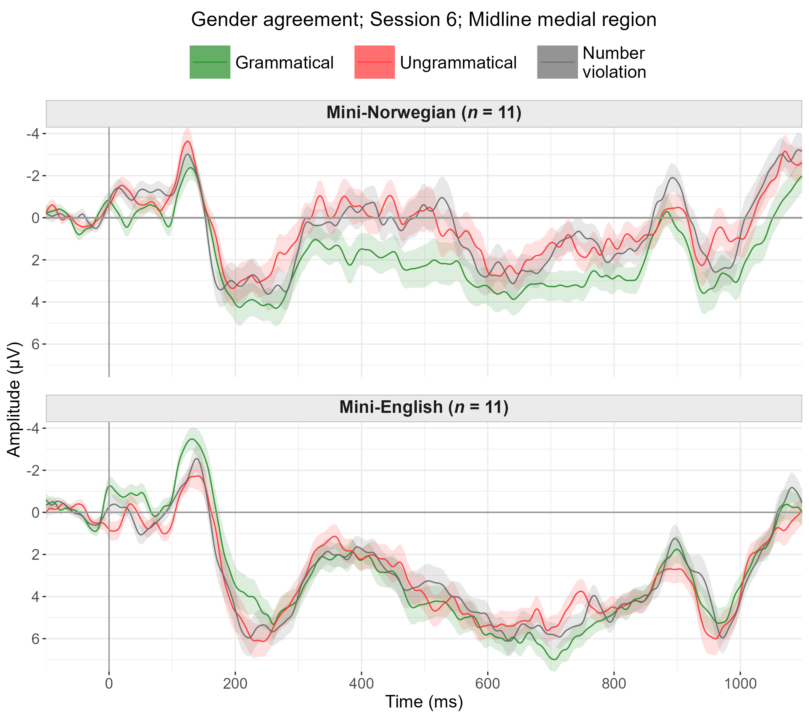

Slide 83
Differential object marking

Slide 84
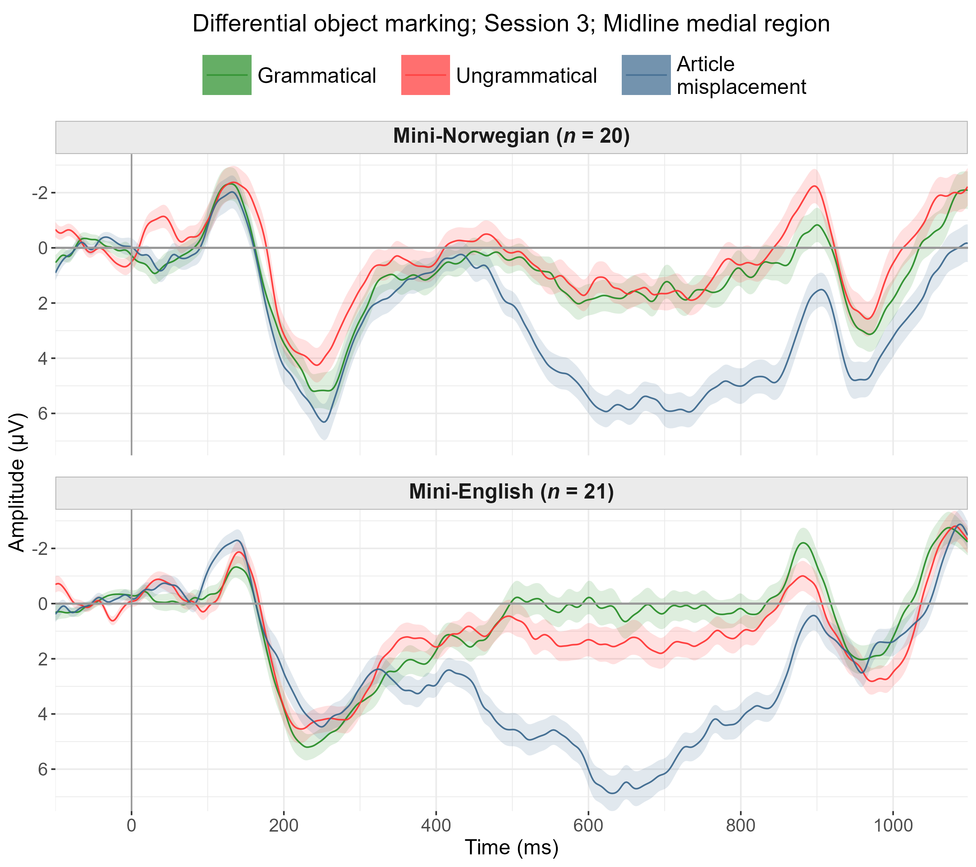

Slide 85
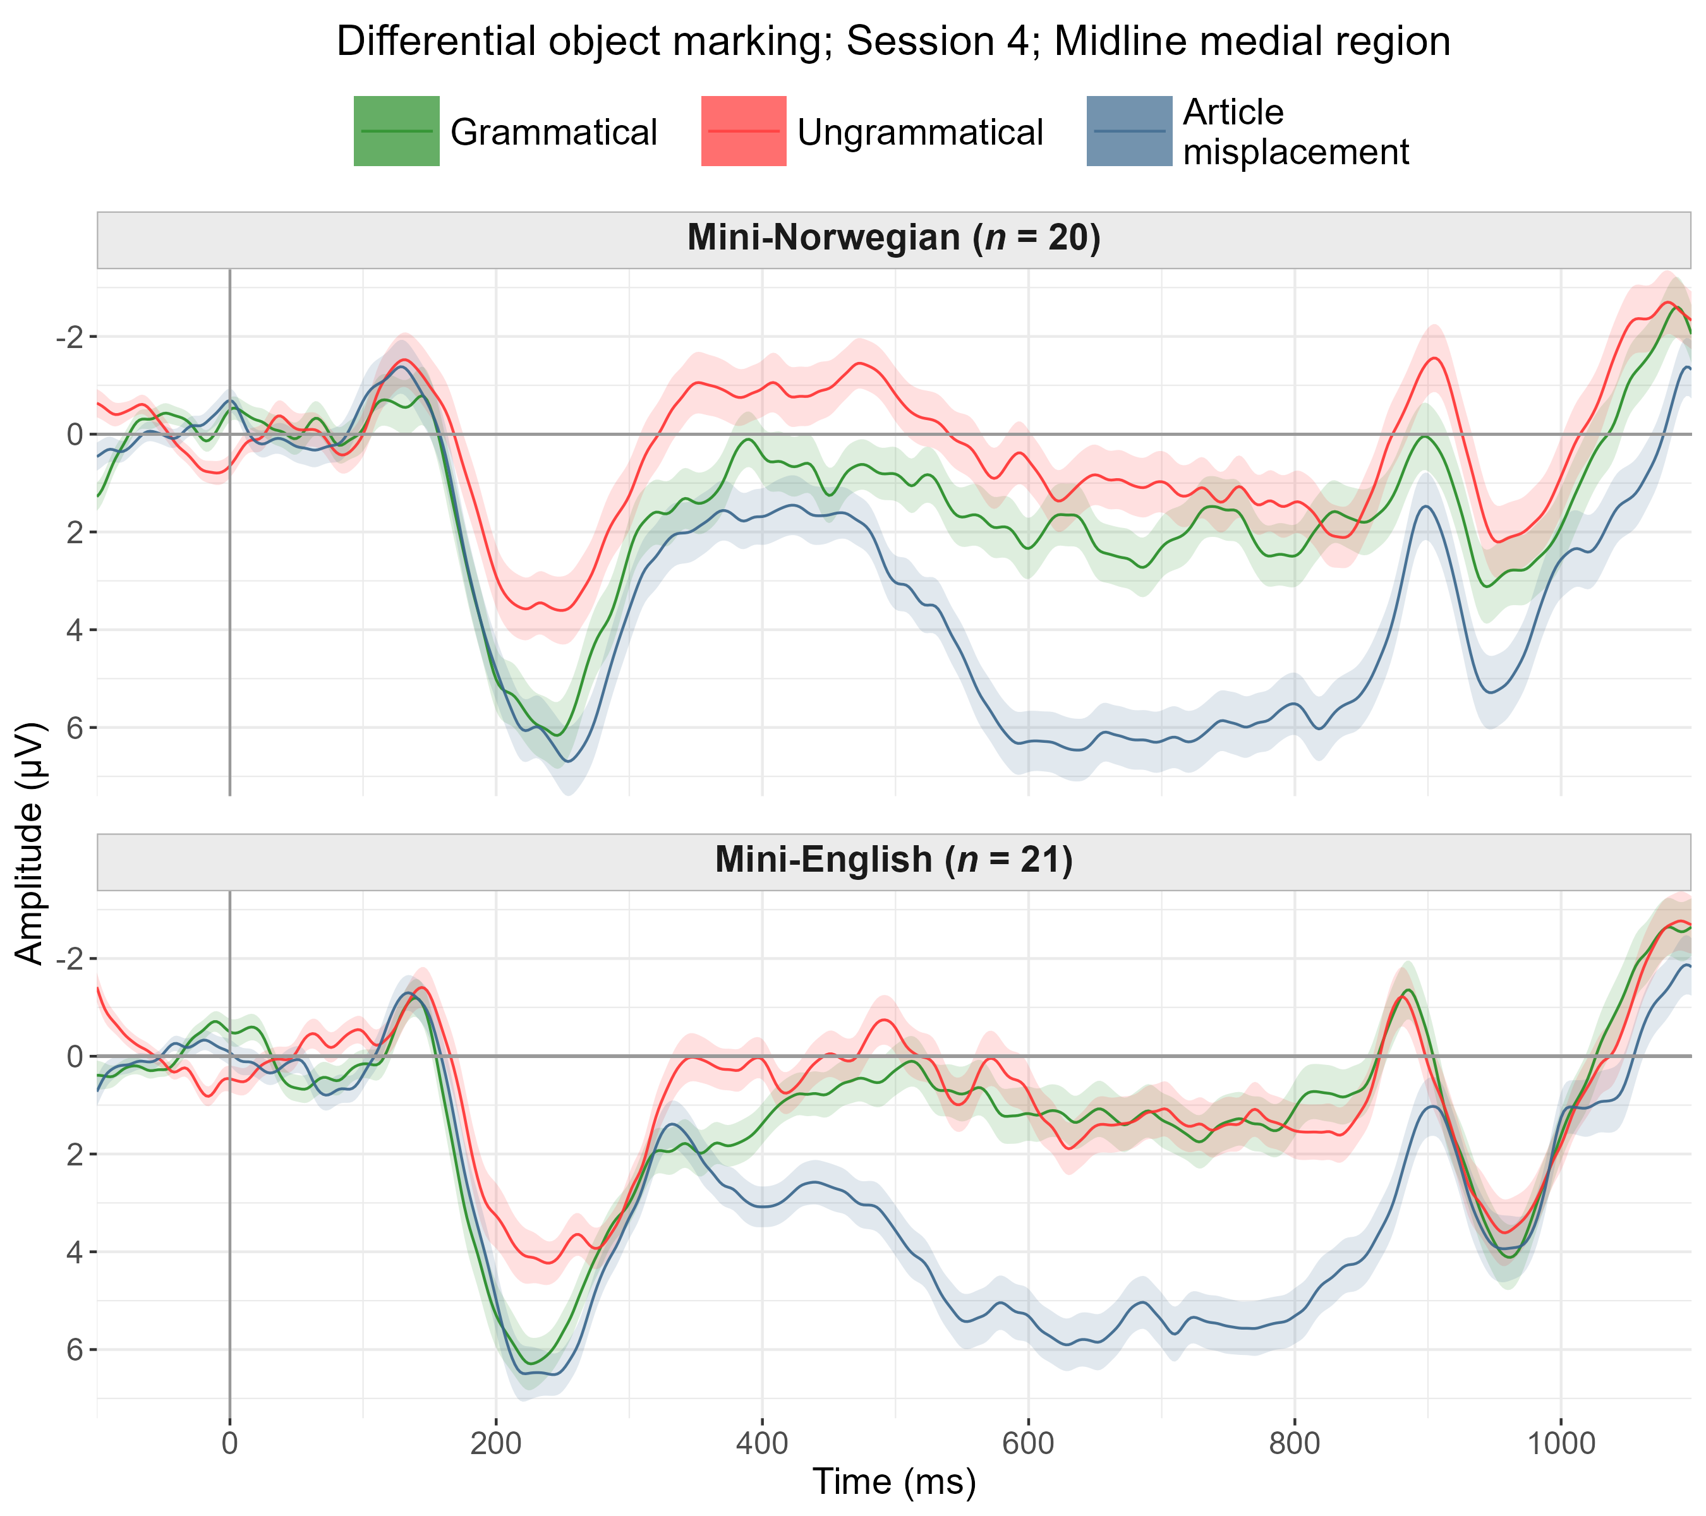

Slide 86
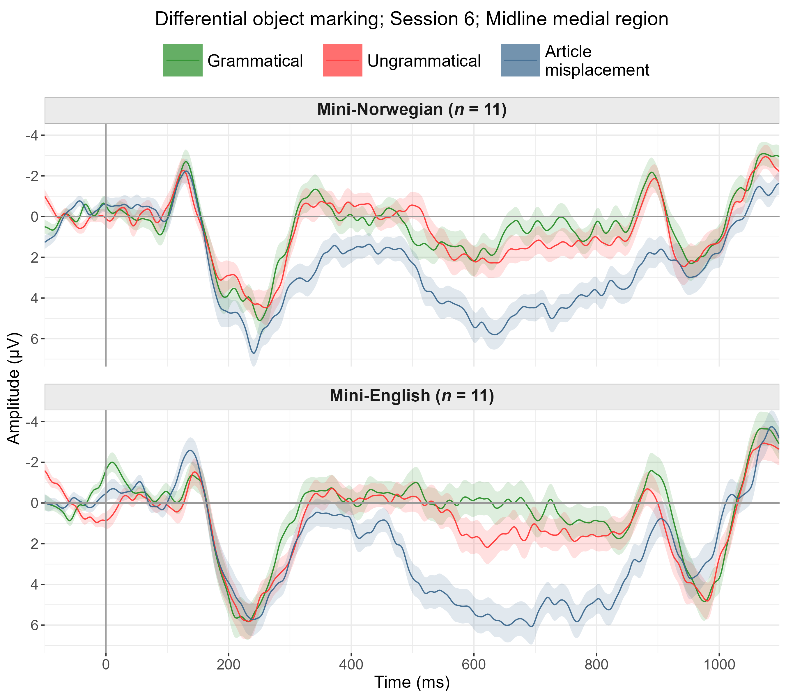

Slide 87
Verb-object agreement

Slide 88
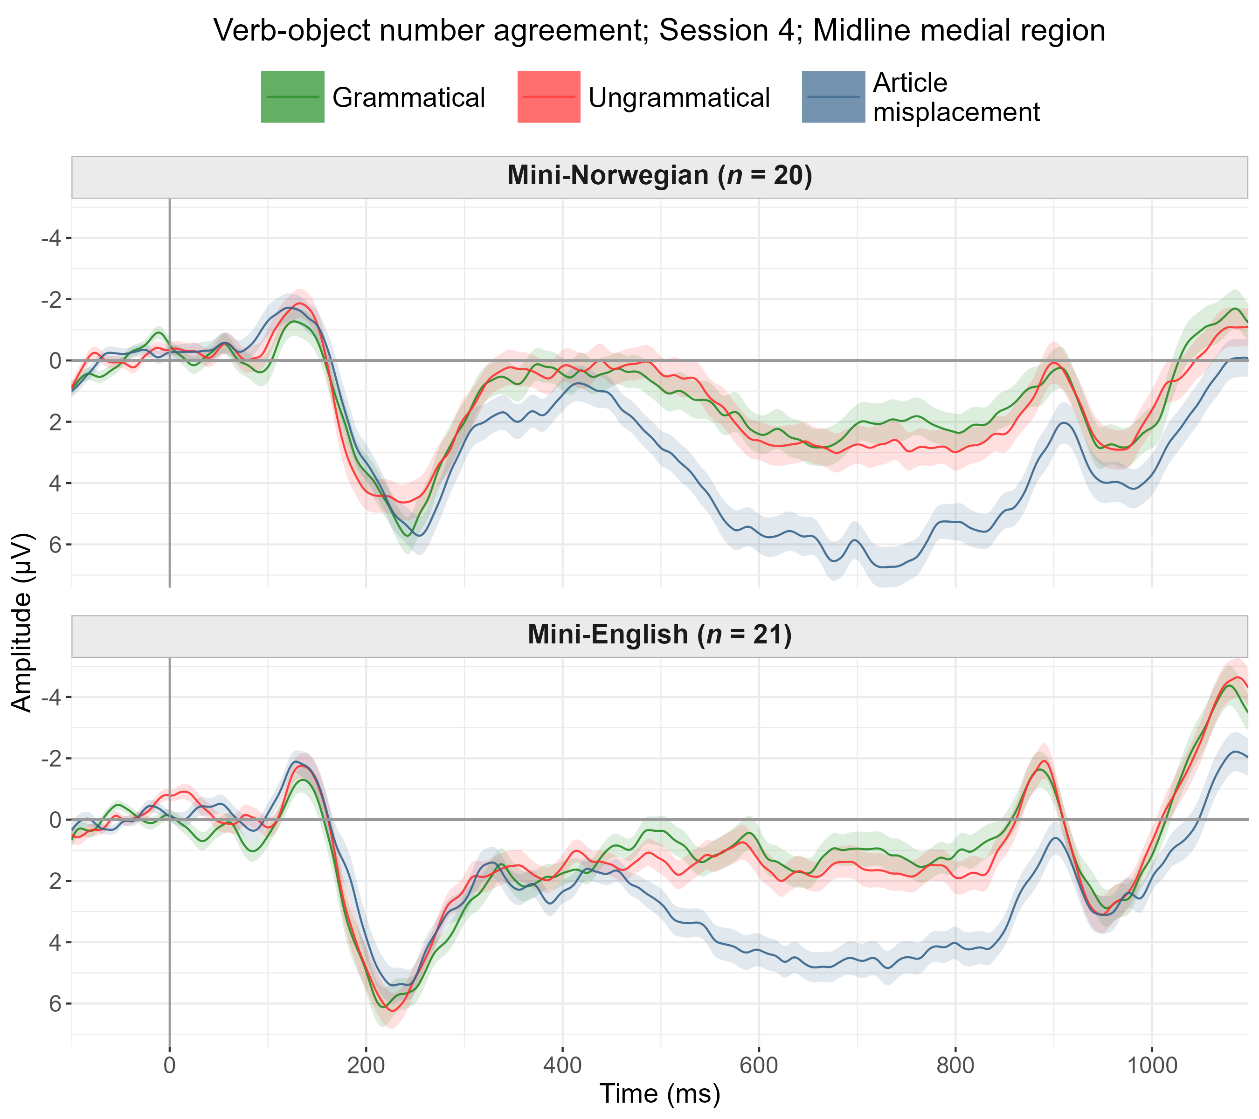

Slide 89
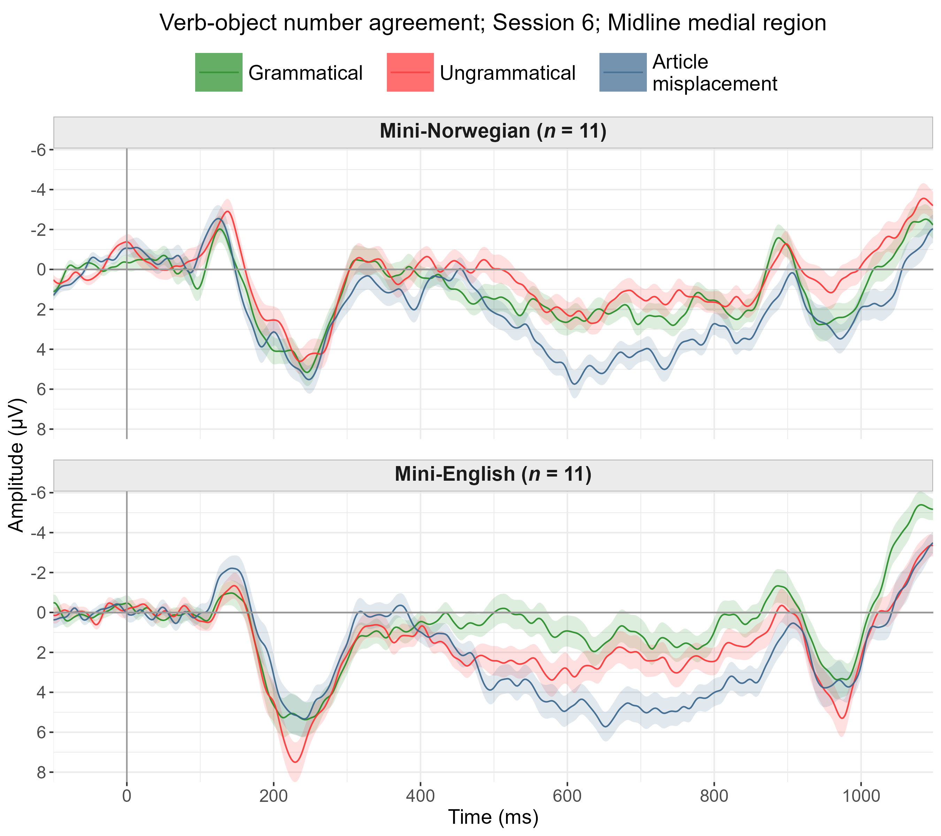

Slide 90
P600-like effect for misplaced articles
Control effect is informative.
Data is sensitive enough to detect such a large effect,
suggesting data and preprocessing are sound.
This effect can be compared with the effects of interest,
even though smaller effects are expected for the latter.

Slide 91
Analysis of ERPs for gender agreement
Data filtered to grammatical and ungrammatical conditions only.
Categorical predictors numerically recoded in logical ways.
Session: 0, 1, 2, 3
Grammaticality: -0.5, 0.5
Dependent and independent variables z-scored (Brauer & Curtin, 2018)
Trial-by-trial mixed-effects model incl. baseline (Alday, 2019).
Per time window (200–500, 300–600, 400–900 ms).
Per macro-region (lateral or midline electrodes).

Slide 92
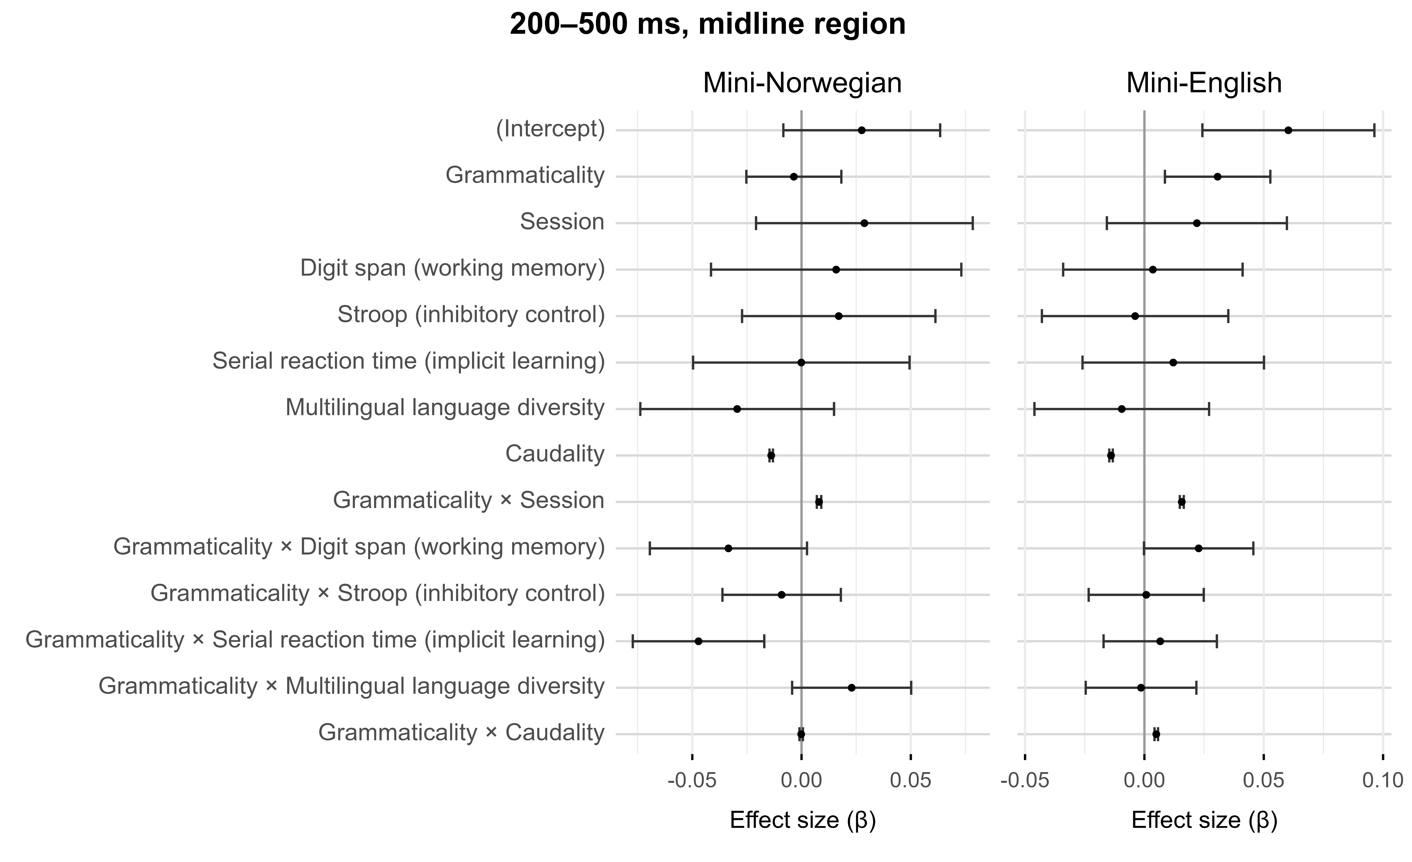

Slide 93
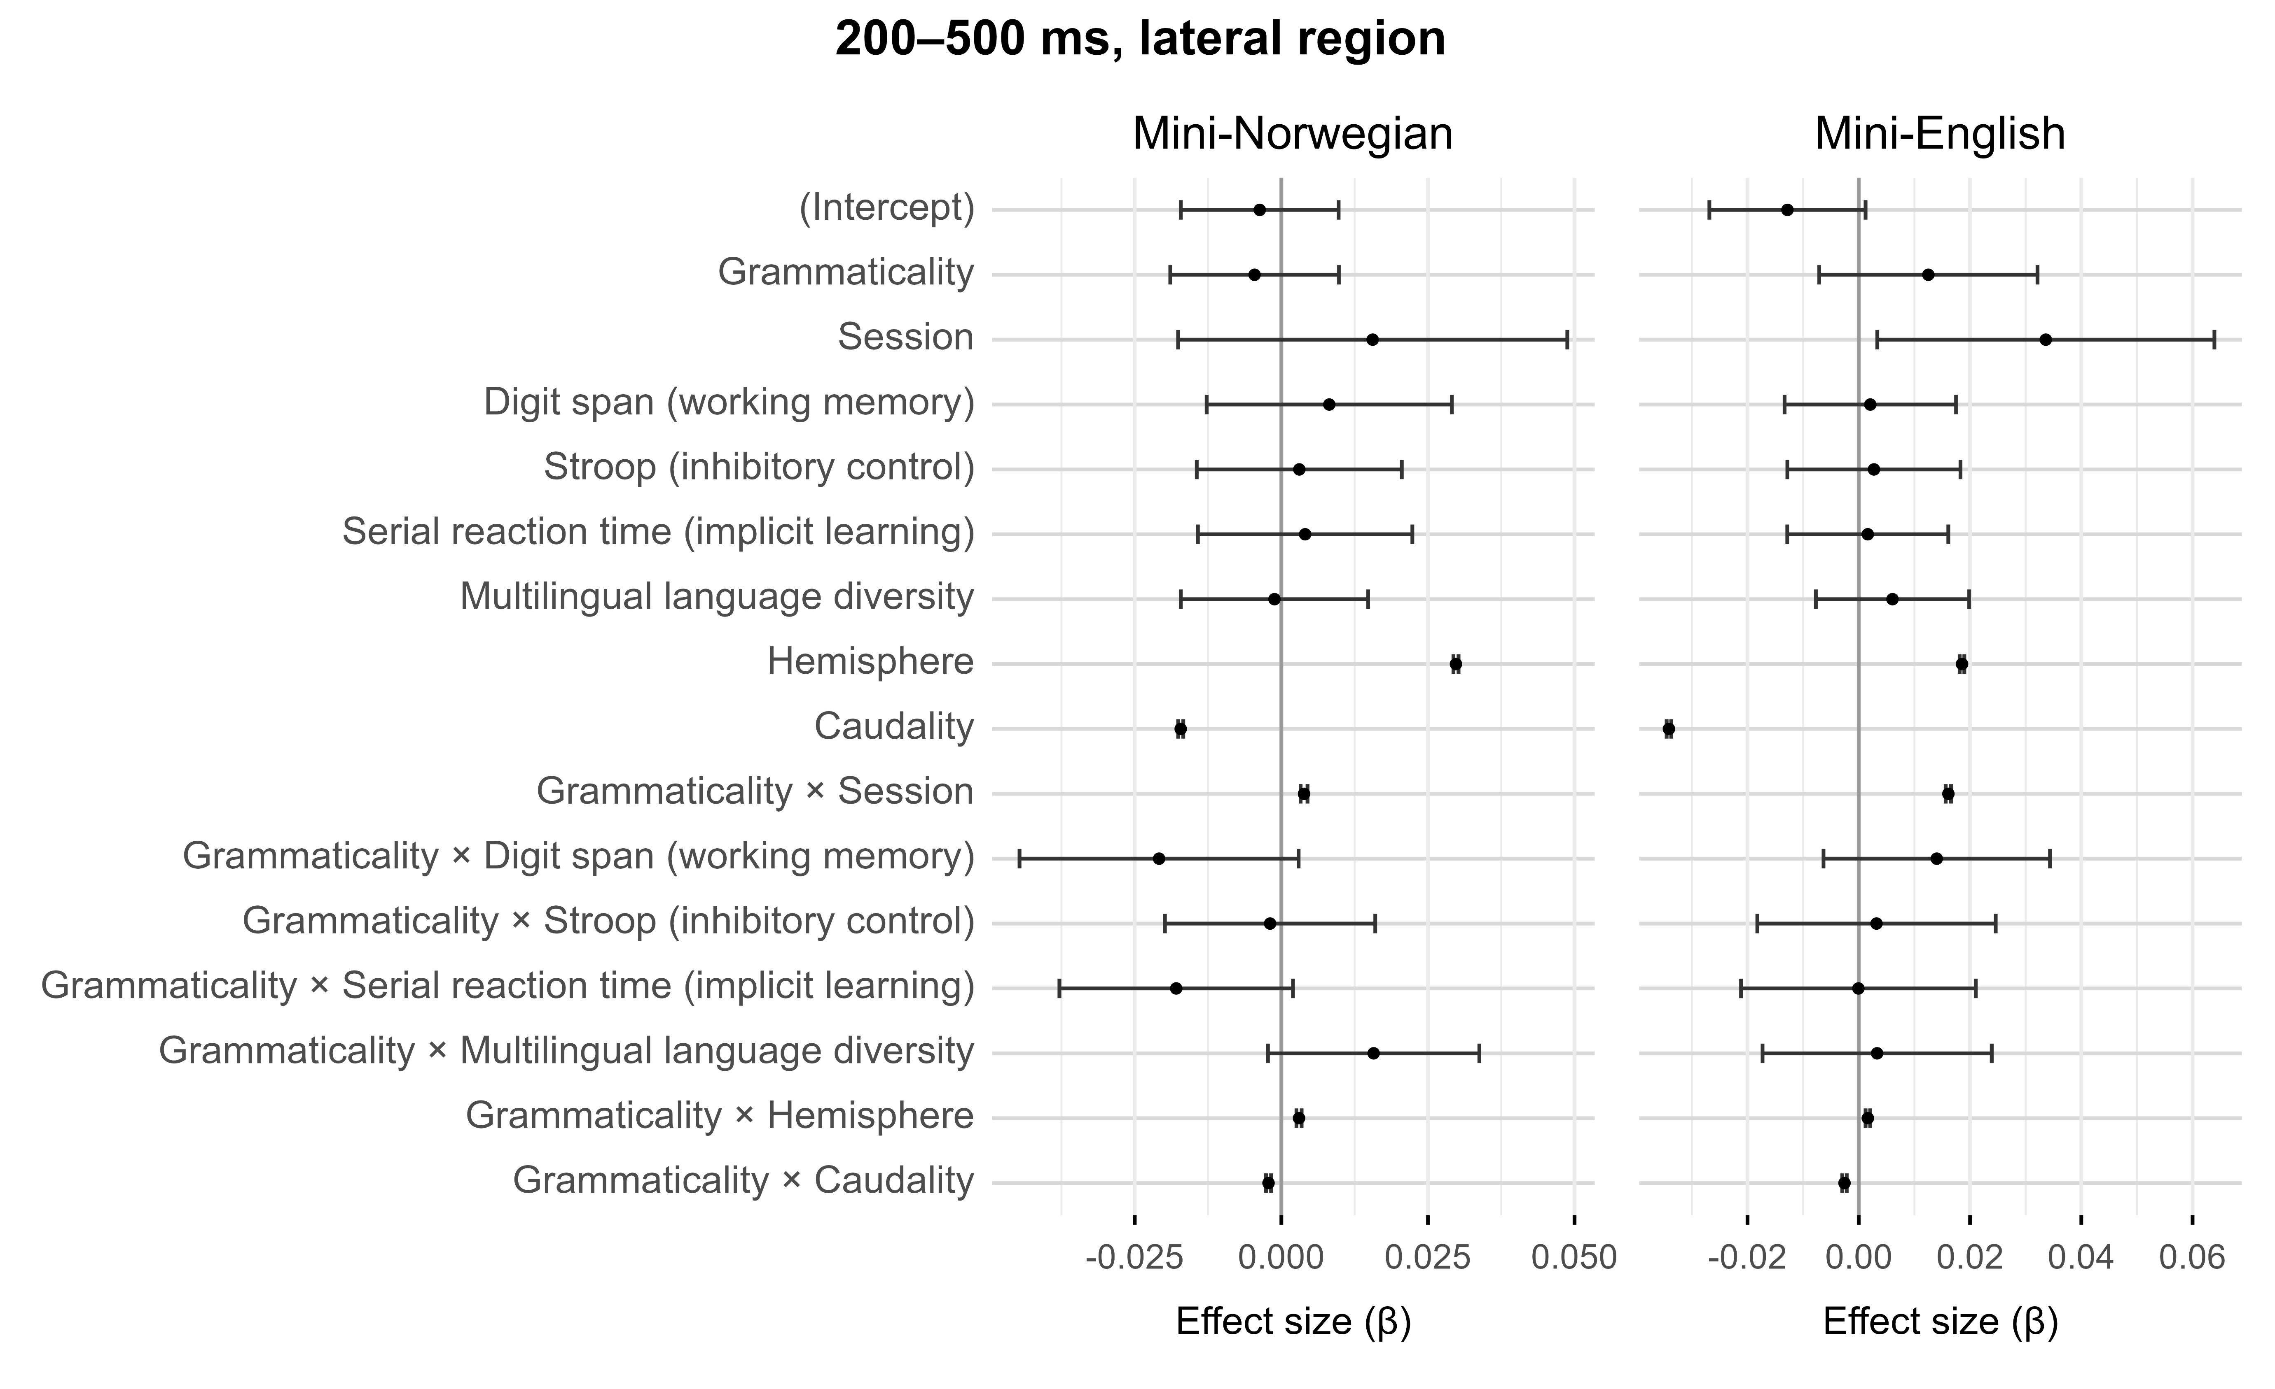

Slide 94


Slide 95
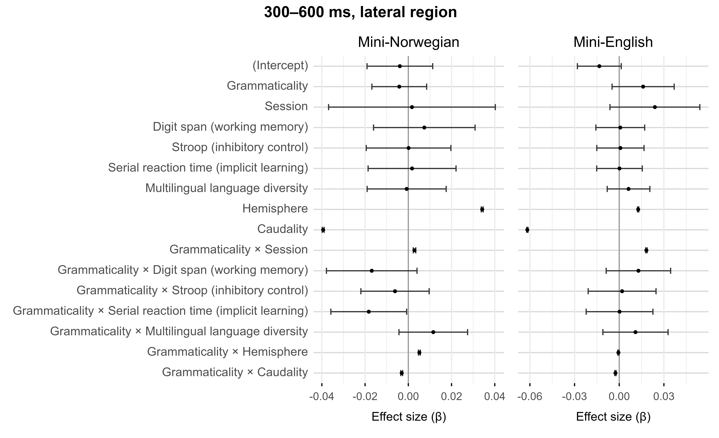

Slide 96
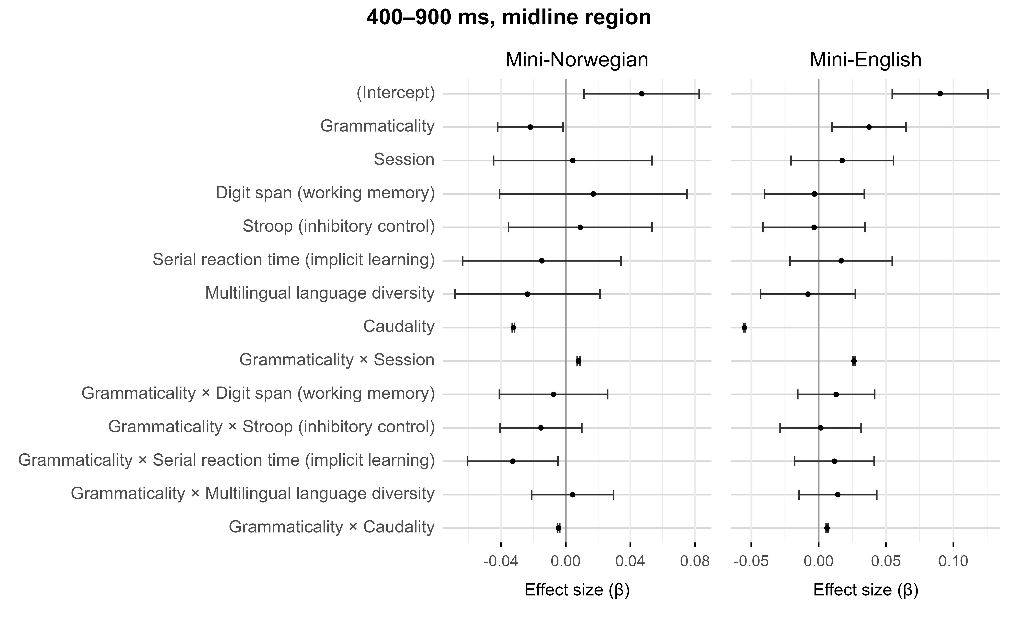

Slide 97
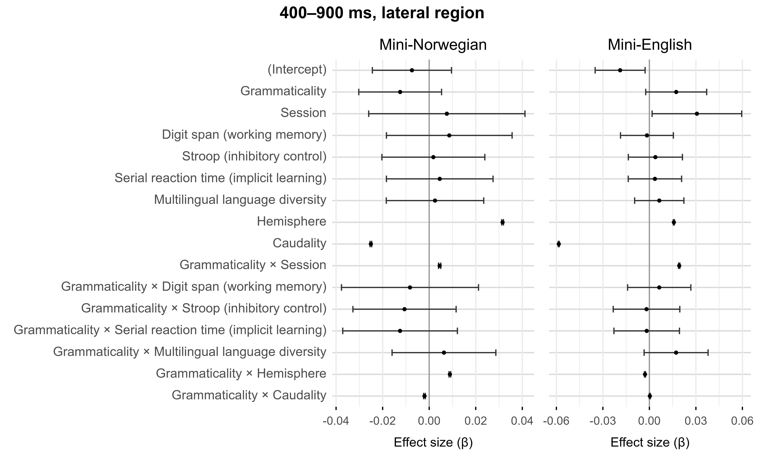

Slide 98
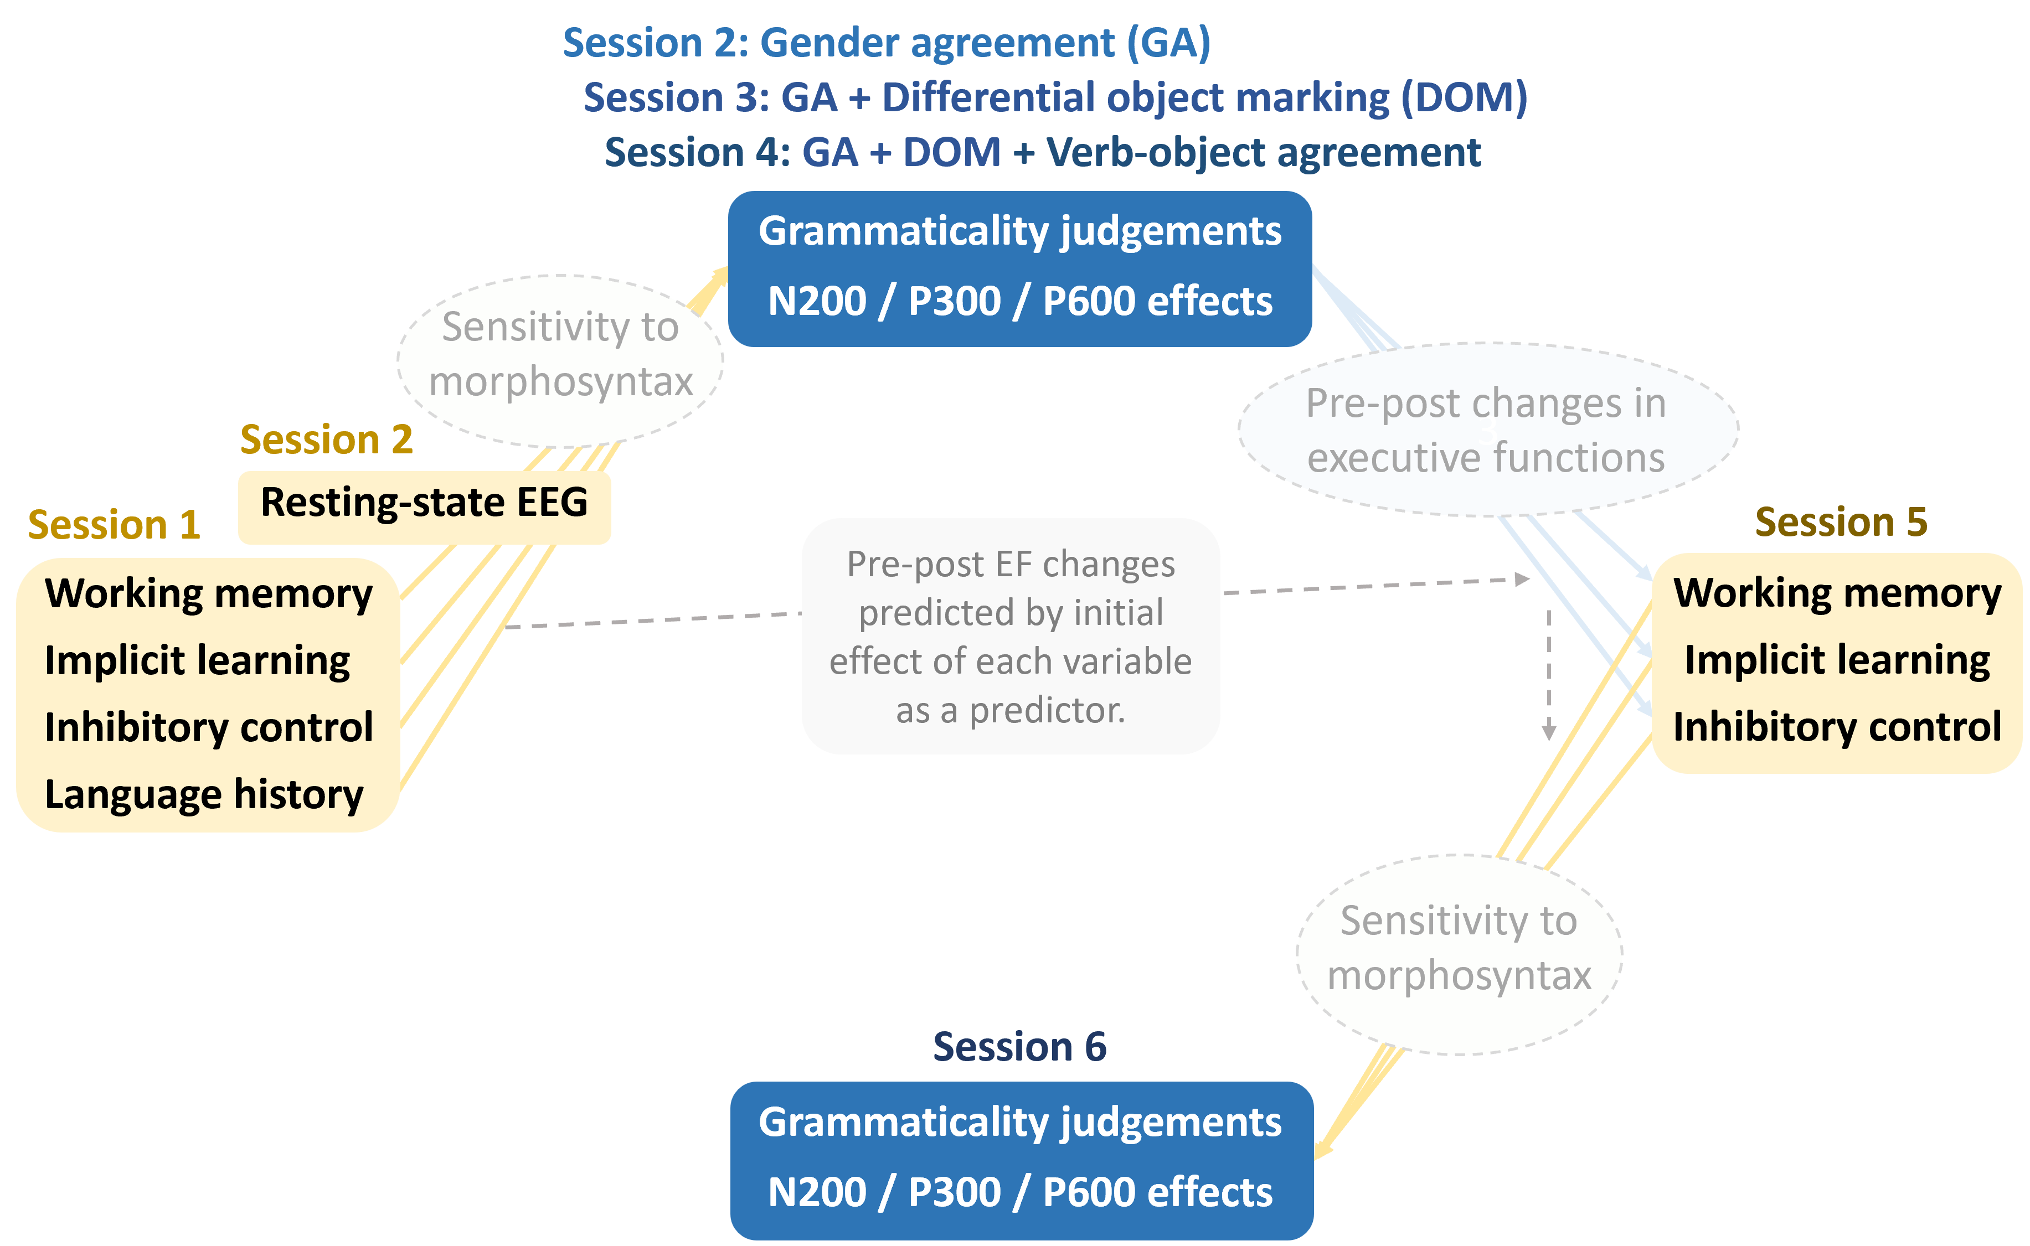
Further analyses and hypotheses

Slide 99
Refresher on the Sessions
Session 1. Individual differences (home-based session)
Working memory (digit span), selective attention (Stroop) and implicit learning (serial reaction time)
Language History Questionnaire (LHQ3; Li et al., 2020)
+ 1 week: Session 2. Gender agreement
Session begins with resting-state EEG (eyes-open, eyes-closed counterbalanced across participants)
+ 1 week: Session 3. Differential object marking + Gender agreement
Training only in the new property
Experiment part contains both properties intermixed
+ 1 week: Session 4. Verb-object agreement + Differential object marking + Gender agreement
Same mechanism as in the previous session
+ 1 week: Session 5. Retest of executive functions (home-based session)
+ 4 months: Session 6. Retest of all grammatical properties (Morgan-Short et al., 2012)
Session ends with control tests on the relevant properties in the natural languages

Slide 100
Executive functions and rs-EEG
Primarily methodological analyses focussed on longitudinal stability.
Analysed first as independent variables, and second as dependent variables.

Slide 101
Longitudinal role of executive functions and rs-EEG
Independent-variable analysis: longitudinal stability (i.e., test-retest reliability) of the variables (for similar analyses, see Fuhs et al., 2014; Samuels et al., 2016; Swanson, 2015).
First analysis: longitudinal stability of the executive functions and rs-EEG on their own.
Second analysis: longitudinal stability of the executive functions and rs-EEG as predictors of language learning and morphosyntactic transfer over time.

Slide 102
Longitudinal effects on executive functions and rs-EEG
Dependent-variable analysis: whether cognitive enhancements in each executive function (incl. rs-EEG) induced by language training are consistent with the baseline role of each executive function (incl. rs-EEG).
Cognitive enhancements analysed relative to the effect of each executive function (incl. rs-EEG) as a predictor of language-learning performance following first exposure—i.e., in the first test on the artificial language.
Analysis intended to increase the methodological basis for the selection of measures to study training-induced cognitive enhancements (see Grossmann et al., 2023; Kliesch et al., 2022; Meltzer et al., 2023).
Pre-post effects not analysed in absolute terms due to lack of control group (Sala & Gobet, 2017).

Slide 103
Language learning: Analyses and hypotheses

Slide 104
Language learning
Hypothesis 1: greater executive functions (overall, incl. rs-EEG) → better language learning
Exploratory analysis: relative importance of the four executive function measures
Hypotheses to be set a priori where possible
Hypothesis 2: greater executive functions (overall, incl. rs-EEG) → greater longitudinal improvements in language learning due to better accumulation of knowledge
Hypothesis 3: longitudinal retests in the grammatical properties → better language learning

Slide 105
Morphosyntactic transfer: Analyses and hypotheses

Slide 106
Standardised numeric predictions
Effect sizes standardised between 0 and 10
Visualisation of numerous comparisons across conditions and models
Pave the way towards computational models with numeric predictions

Slide 107
Standardised numeric predictions
Effect sizes standardised between 0 and 10
Visualisation of numerous comparisons across conditions and models
Pave the way towards computational models with numeric predictions
Norway site predictions
Property | Artificial lang. | L2SFM | CEM | LPM | TPM
 |  | L2 default | prop. by prop. | prop. by prop. | full transfer
Gender agreement | Mini-Norwegian | 0 | 10 | 5-10 | 10
 | Mini-English | 10 | 10 | 0-5 | 0-2
Differential object marking | Mini-Norwegian | 0-3 | 0-3 | 0-2 | 0-2
 | Mini-English | 0-3 | 0-3 | 0-3 | 0-3
Verb-object number agreem. | Mini-Norwegian | 0-3 | 3 | 0-6 | 0-5
 | Mini-English | 0-3 | 3 | 0-3 | 0-3

Slide 108
Spain site predictions
Property | Group | Artificial lang. | L2SFM | CEM | LPM | TPM
 |  |  | L2 default | prop. by prop. | prop. by prop. | full transfer
Gender agreement | L1 Eng, L2 Spa | Mini-Spanish | 10? | 10 | 5-10 | 10
 | L1 Eng L2 Sp | Mini-English | 10? | 10 | 5-7 | 0
 | L1 Spa, L2 Eng | Mini-Spanish | 0 | 10 | 5-10 | 10
 | L1 Sp L2 Eng | Mini-English | 0 | 10 | 0-5 | 0
Differential object marking | L1 Eng, L2 Spa | Mini-Spanish | 8? | 8 | 5-8 | 8
 | L1 Eng L2 Sp | Mini-English | 8? | 8 | 0-5 | 0-2
 | L1 Spa, L2 Eng | Mini-Spanish | 0 | 8 | 5-8 | 8
 | L1 Sp L2 Eng | Mini-English | 0 | 8 | 0-5 | 0-2
Verb-object number agreement | L1 Eng, L2 Spa | Mini-Spanish | 0-5? | 0-3 | 0-4 | 0-3
 | L1 Eng L2 Sp | Mini-English | 0-5? | 0-3 | 0-2 | 0-2
 | L1 Spa, L2 Eng | Mini-Spanish | 0-3 | 0-3 | 0-4 | 0-3
 | L1 Sp L2 Eng | Mini-English | 0-3 | 0-3 | 0-3 | 0-2

Slide 109
Executive functions and morphosyntactic transfer
Hypothesis 1: greater executive functions (overall, incl. rs-EEG) → greater precursors of transfer (N2, P3)
Hypothesis 2: greater executive functions (overall , incl. rs-EEG) → greater signatures of transfer (P600)

Slide 110
Longitudinal effects in morphosyntactic transfer
Hypothesis 1: any signatures of transfer (esp. P600) more likely to occur in later sessions.
Hypothesis 2: any signatures of transfer (esp. P600) should persist in subsequent sessions.

Slide 111
Thank you
Questions and feedback very welcome.

Slide 112
References (1/5)
Alday, P. M. (2019). How much baseline correction do we need in ERP research? Extended GLM model can replace baseline correction while lifting its limits. Psychophysiology, 56(12), e13451. https://doi.org/10.1111/psyp.13451
Bardel, C., & Falk, Y. (2012). The L2 status factor and the declarative/procedural distinction. In J. Cabrelli, S. Flynn, & J. Rothman (Eds.), Third Language Acquisition in Adulthood (pp. 61–78). John Benjamins Publishing Company. https://doi.org/10.1075/sibil.46.06bar
Desbordes, T., Lakretz, Y., Chanoine, V., Oquab, M., Badier, J.-M., Trébuchon, A., Carron, R., Bénar, C.-G., Dehaene, S., & King, J.-R. (2023). Dimensionality and ramping: Signatures of sentence integration in the dynamics of brains and deep language models. Journal of Neuroscience, 43(29), 5350–5364. https://doi.org/10.1523/JNEUROSCI.1163-22.2023
Flynn, S., Foley, C., & Vinnitskaya, I. (2004). The cumulative-enhancement model for language acquisition: Comparing adults’ and children’s patterns of development in first, second and third language acquisition of relative clauses. International Journal of Multilingualism, 1(1), 3–16. https://doi.org/10.1080/14790710408668175
Friederici, A. D., Steinhauer, K., & Pfeifer, E. (2002). Brain signatures of artificial language processing: Evidence challenging the critical period hypothesis. Proceedings of the National Academy of Sciences, 99(1), 529–534. https://doi.org/10.1073/pnas.012611199
Fuhs, M. W., Nesbitt, K. T., Farran, D. C., & Dong, N. (2014). Longitudinal associations between executive functioning and academic skills across content areas. Developmental Psychology, 50(6), 1698–1709. https://doi.org/10.1037/a0036633

Slide 113
References (2/5)
González Alonso, J., Bernabeu, P., Silva, G., DeLuca, V., Poch, C., Ivanova, I., & Rothman, J. (2025). Starting from the very beginning: Unraveling Third Language (L3) Development with Longitudinal Data from Artificial Language Learning and EEG. International Journal of Multilingualism, 22(1), 119–142. https://doi.org/10.1080/14790718.2024.2415993
Grossmann, J. A., Aschenbrenner, S., Teichmann, B., & Meyer, P. (2023). Foreign language learning can improve response inhibition in individuals with lower baseline cognition: Results from a randomized controlled superiority trial. Frontiers in Aging Neuroscience, 15. https://doi.org/10.3389/fnagi.2023.1123185
Hudson Kam, C. L., & Newport, E. L. (2005). Regularizing unpredictable variation: The roles of adult and child learners in language formation and change. Language Learning and Development, 1(2), 151–195. https://doi.org/10.1080/15475441.2005.9684215
Just, M. A., & Carpenter, P. A. (1980). A theory of reading: From eye fixations to comprehension. Psychological Review, 87(4), 329–354. https://doi.org/10.1037/0033-295X.87.4.329
Kliesch, M., Pfenninger, S. E., Wieling, M., Stark, E., & Meyer, M. (2022). Cognitive benefits of learning additional languages in old adulthood? Insights from an intensive longitudinal intervention study. Applied Linguistics, 43(4), 653–676. https://doi.org/10.1093/applin/amab077
Li, P., Zhang, F., Yu, A., & Zhao, X. (2020). Language History Questionnaire (LHQ3): An enhanced tool for assessing multilingual experience. Bilingualism: Language and Cognition, 23(5), 938–944. https://doi.org/10.1017/S1366728918001153

Slide 114
References (3/5)
Meltzer, J. A., Kates Rose, M., Le, A. Y., Spencer, K. A., Goldstein, L., Gubanova, A., Lai, A. C., Yossofzai, M., Armstrong, S. E. M., & Bialystok, E. (2023). Improvement in executive function for older adults through smartphone apps: A randomized clinical trial comparing language learning and brain training. Aging, Neuropsychology, and Cognition, 30(2), 150–171. https://doi.org/10.1080/13825585.2021.1991262
Meister, C., Pimentel, T., Clark, T., Cotterell, R., & Levy, R. (2022). Analyzing wrap-up effects through an information-theoretic lens. In S. Muresan, P. Nakov, & A. Villavicencio (Eds.), Proceedings of the 60th Annual Meeting of the Association for Computational Linguistics (Volume 2: Short Papers) (pp. 20–28). Association for Computational Linguistics. https://doi.org/10.18653/v1/2022.acl-short.3
Monaghan, P., Donnelly, S., Alcock, K., Bidgood, A., Cain, K., Durrant, S., Frost, R. L. A., Jago, L. S., Peter, M. S., Pine, J. M., Turnbull, H., & Rowland, C. F. (2023). Learning to generalise but not segment an artificial language at 17 months predicts children’s language skills 3 years later. Cognitive Psychology, 147, 101607. https://doi.org/10.1016/j.cogpsych.2023.101607
Morgan-Short, K., Finger, I., Grey, S., & Ullman, M. T. (2012). Second language processing shows increased native-like neural responses after months of no exposure. PLOS ONE, 7(3), e32974. https://doi.org/10.1371/journal.pone.0032974
Pereira Soares, S. M., Kupisch, T., & Rothman, J. (2022). Testing potential transfer effects in heritage and adult L2 bilinguals acquiring a mini grammar as an additional language: An ERP approach. Brain Sciences, 12(5), 669. https://doi.org/10.3390/brainsci12050669

Slide 115
References (4/5)
Rothman, J. (2011). L3 syntactic transfer selectivity and typological determinacy: The typological primacy model. Second Language Research, 27(1), 107–127. https://doi.org/10.1177/0267658310386439
Rothman, J., Alemán Bañón, J., & González Alonso, J. (2015). Neurolinguistic measures of typological effects in multilingual transfer: Introducing an ERP methodology. Frontiers in Psychology, 6. https://doi.org/10.3389/fpsyg.2015.01087
Sala, G., & Gobet, F. (2017). Does far transfer exist? Negative evidence from chess, music, and working memory training. Current Directions in Psychological Science, 26(6), 515–520. https://doi.org/10.1177/0963721417712760
Samuels, W. E., Tournaki, N., Blackman, S., & Zilinski, C. (2016). Executive functioning predicts academic achievement in middle school: A four-year longitudinal study. The Journal of Educational Research, 109(5), 478–490. https://doi.org/10.1080/00220671.2014.979913
Stowe, L. A., Kaan, E., Sabourin, L., & Taylor, R. C. (2018). The sentence wrap-up dogma. Cognition, 176, 232–247. https://doi.org/10.1016/j.cognition.2018.03.011
Swanson, H. L. (2015). Growth in working memory and inhibition predicts literacy in English language learners: A cross-sectional and longitudinal study. Memory, 23(5), 748–773. https://doi.org/10.1080/09658211.2014.927504
Uddén, J., & Männel, C. (2018). Artificial grammar learning and its neurobiology in relation to language processing and development. In S.-A. Rueschemeyer & M. G. Gaskell (Eds.), The Oxford Handbook of Psycholinguistics (p. 0). Oxford University Press. https://doi.org/10.1093/oxfordhb/9780198786825.013.33

Slide 116
References (5/5)
Wendebourg, K., Öttl, B., Meurers, D., & Kaup, B. (2025). Semantic information boosts the acquisition of a novel grammatical system in different presentation formats. Language and Cognition, 17, e30. https://doi.org/10.1017/langcog.2023.47
Westergaard, M., Mitrofanova, N., Mykhaylyk, R., & Rodina, Y. (2017). Crosslinguistic influence in the acquisition of a third language: The Linguistic Proximity Model. International Journal of Bilingualism, 21(6), 666–682. https://doi.org/10.1177/1367006916648859

